Slide 1


WELCOME TO THE NEXT LEVEL

Slide 2


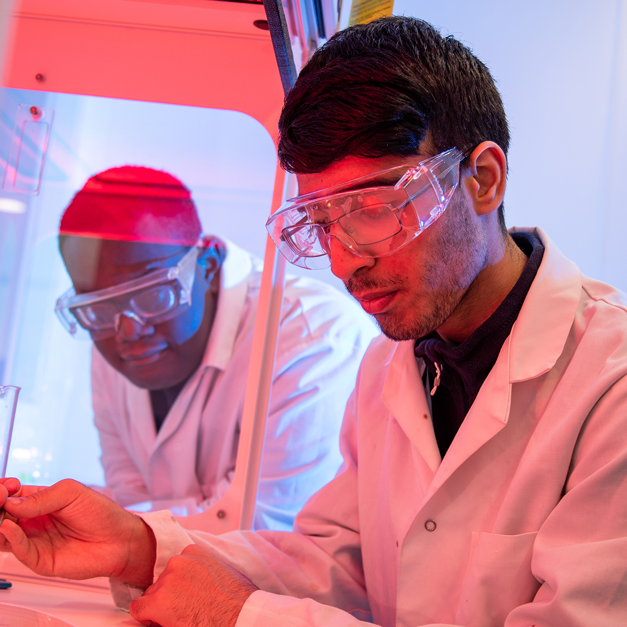
Why choose T Levels?
T Levels are Government driven and a 2 year nationally-recognised qualification.
One T Level is equivalent to 3 A levels
Accepted by universities
(T Level Merit = 120 UCAS points)
Designed and endorsed by employers
Includes a 45-day (315 hours) industry placement to help you learn what a real career is like and prepare you for employment

Slide 3



Slide 4

How are T Levels different to apprenticeships?
Apprenticeships are typically 80% on-the-job and 20% in the classroom, and are more suited to those who are ready to enter the workforce at age 16
T Levels involve more classroom study than apprenticeships and prepare students for work, further training or further study.

Slide 5
T Level Laboratory Science

Slide 6
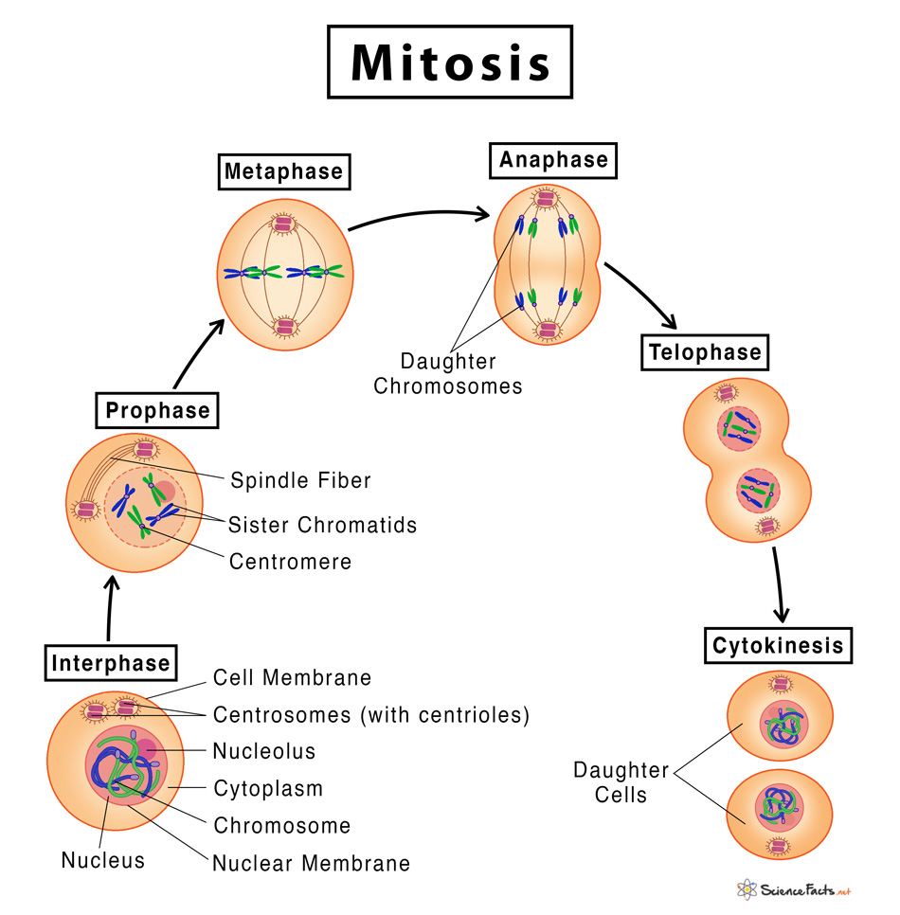
Did you know?
“Interesting People Make A Terrific Curry”

Slide 7
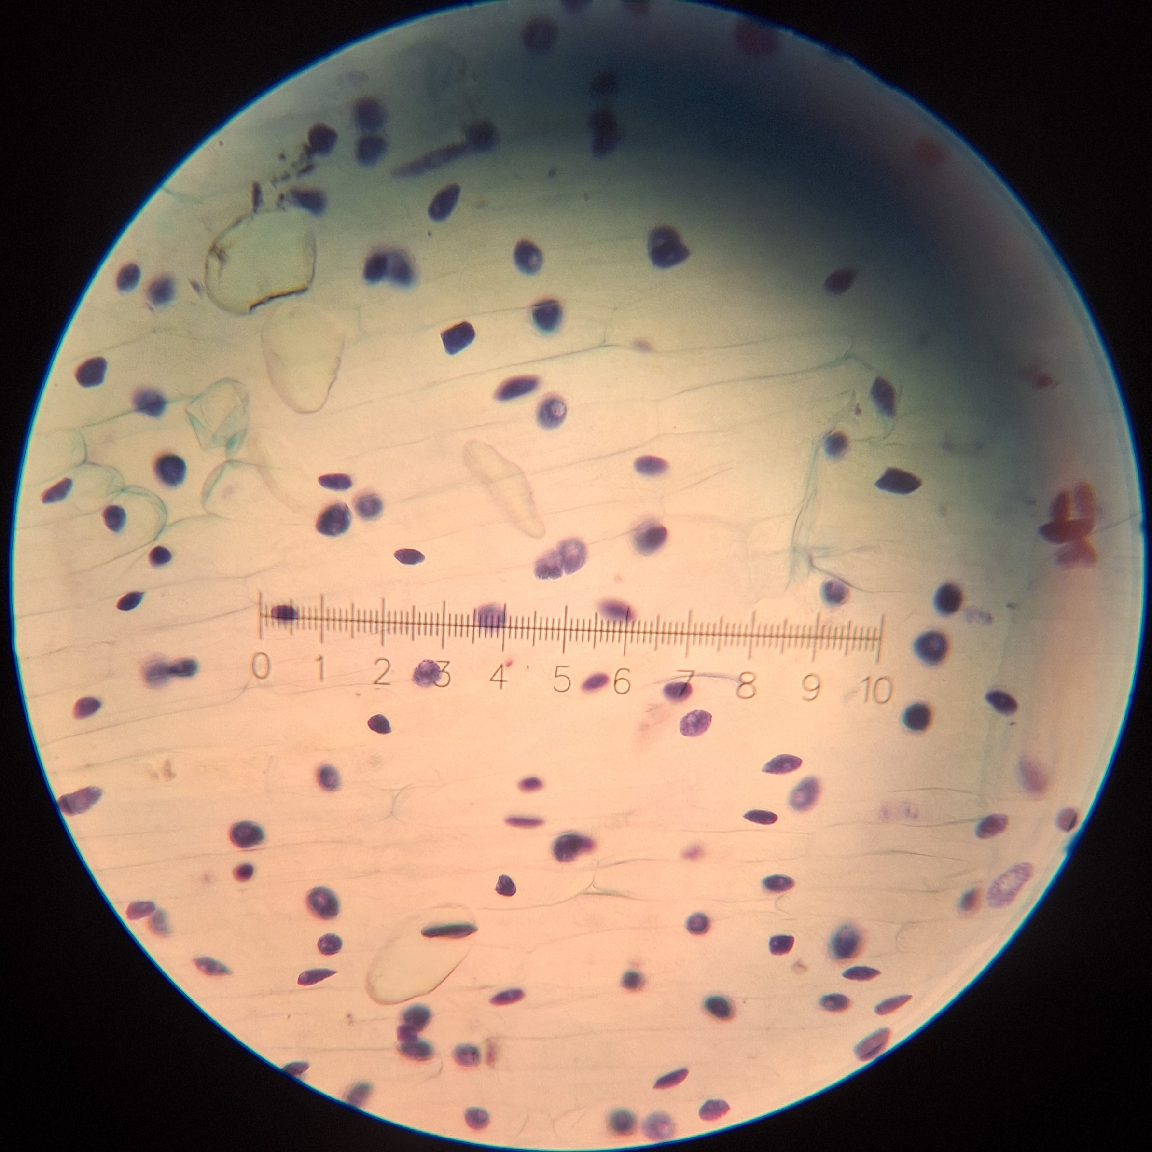
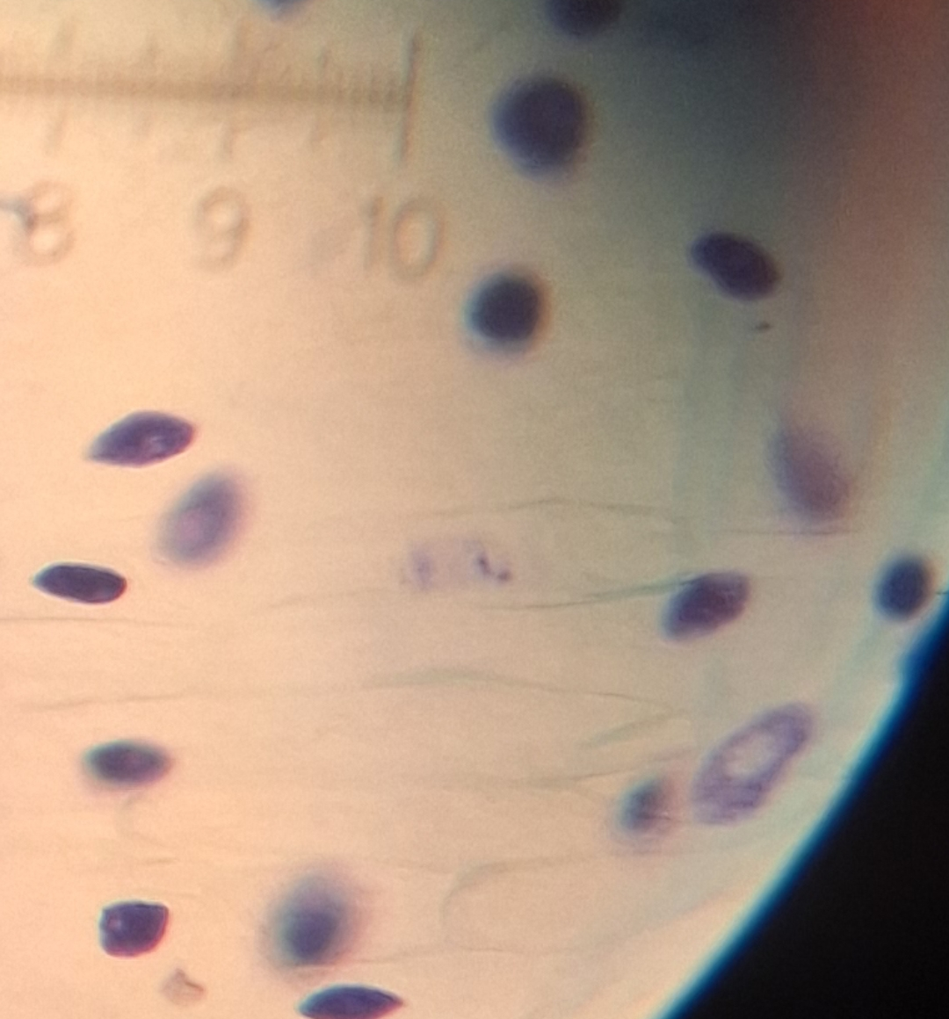
Telophase

Slide 8

How do we know whether an athlete has been using performance enhancing substances?

Slide 9
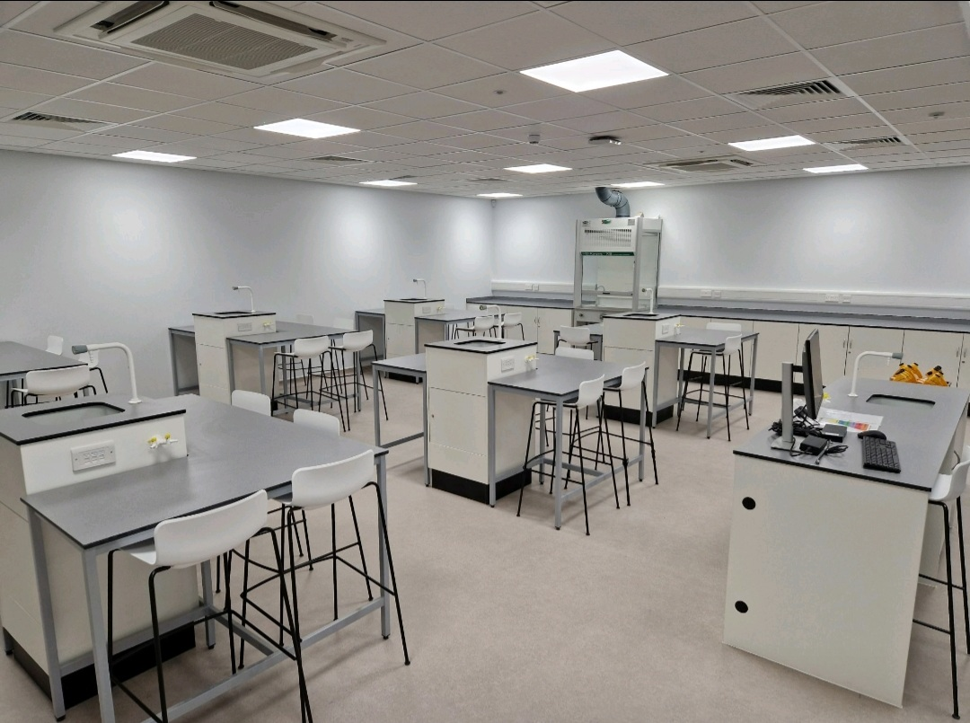
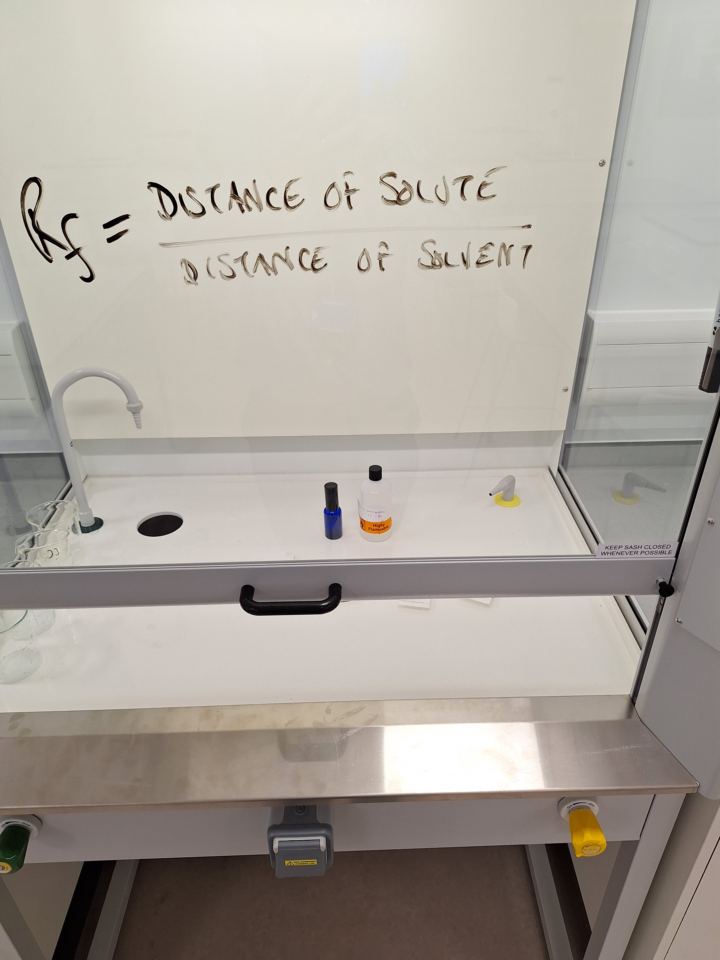

Slide 10
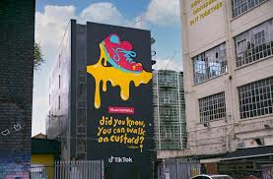
Did you know you can walk on custard but not on water?

Slide 11
T Level Laboratory Science Course Content
T Level Laboratory Science Course Content
Year 1: | Unit A: Working in the sector, Health and Safety, ethics, data management, etc; Unit B: Biology, Chemistry and Physics; Employer Set Project. | Two exams One coursework assignment
Year 2: | Cell Biology; Ecology; Inorganic Chemistry; Organic Chemistry; Physics. | Three coursework assignments

Slide 12
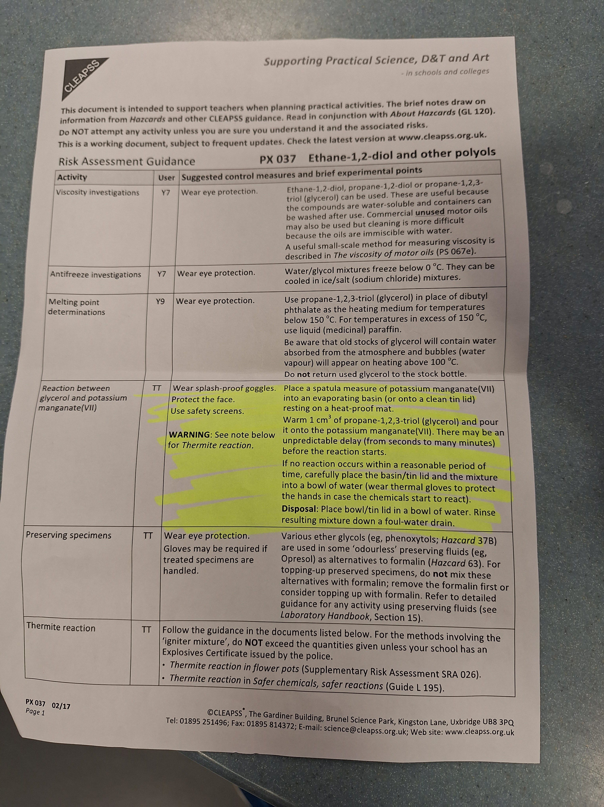
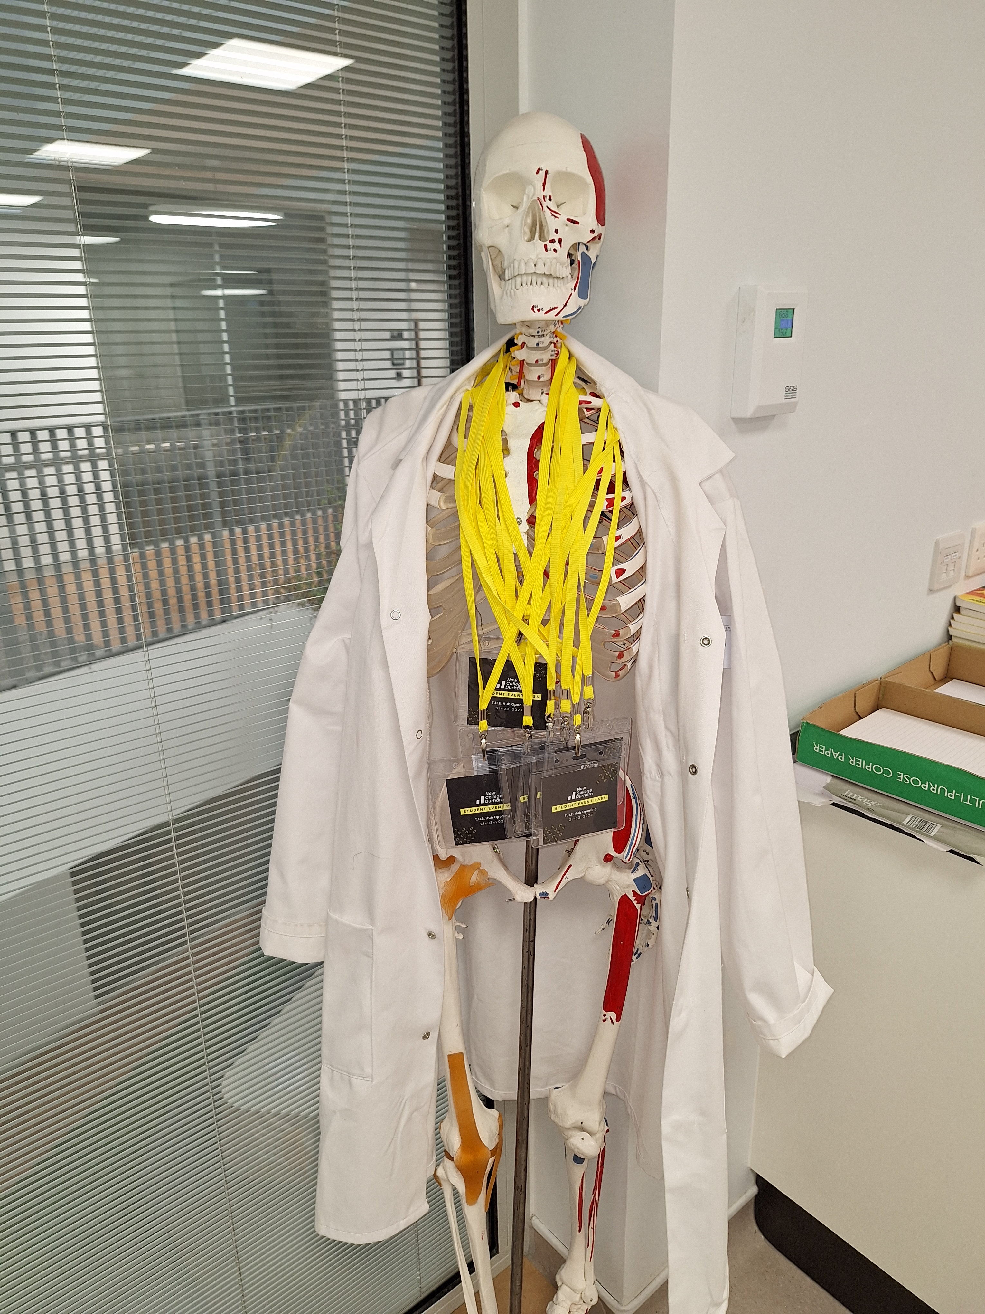

Slide 13
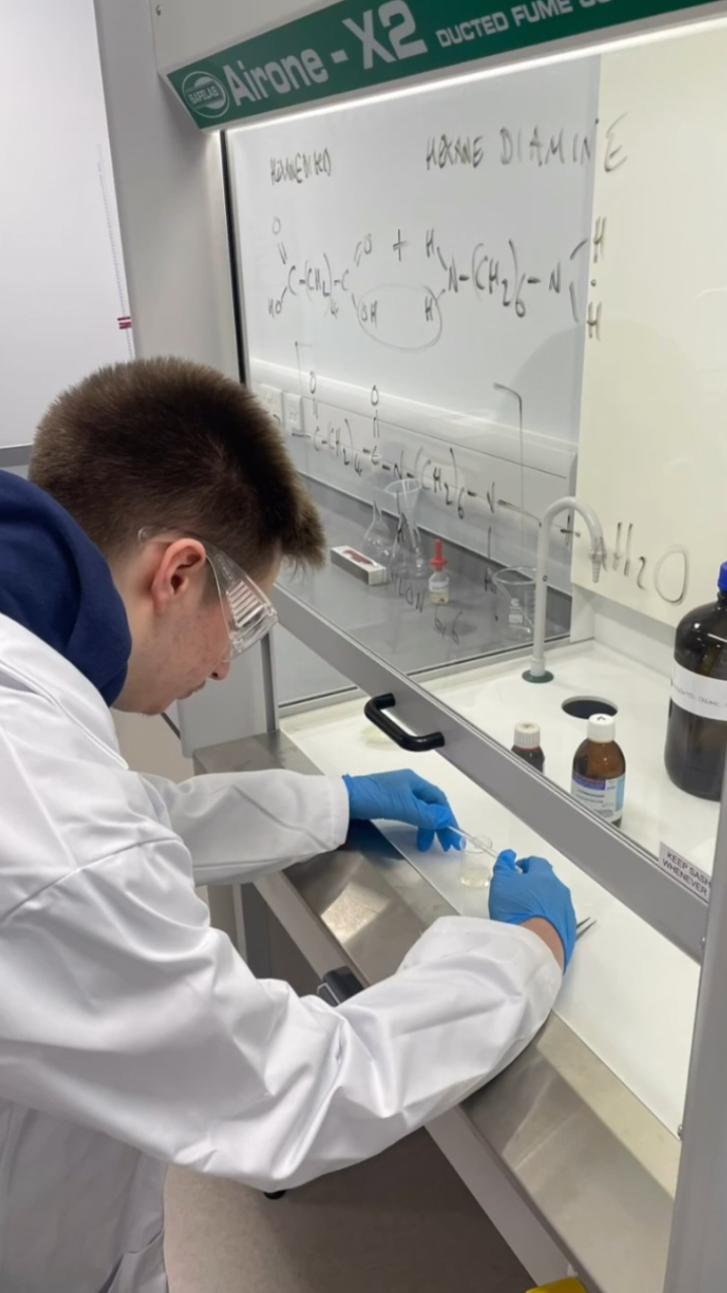
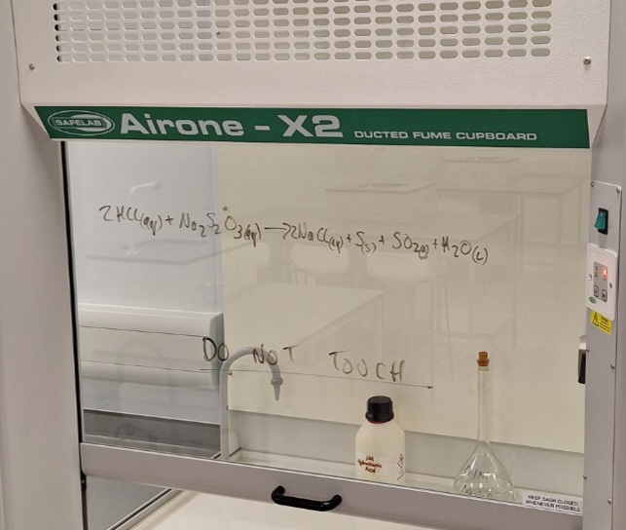

Slide 14
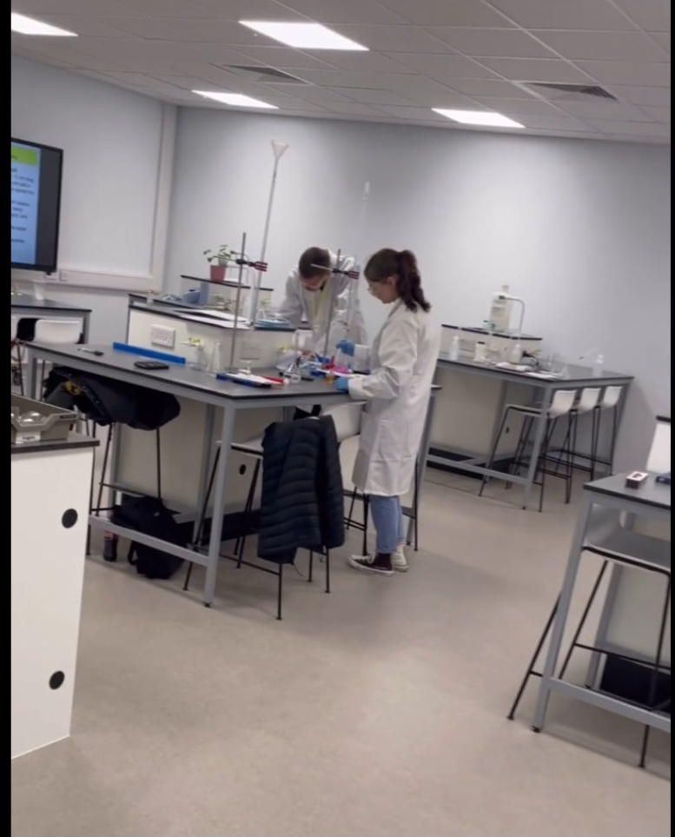
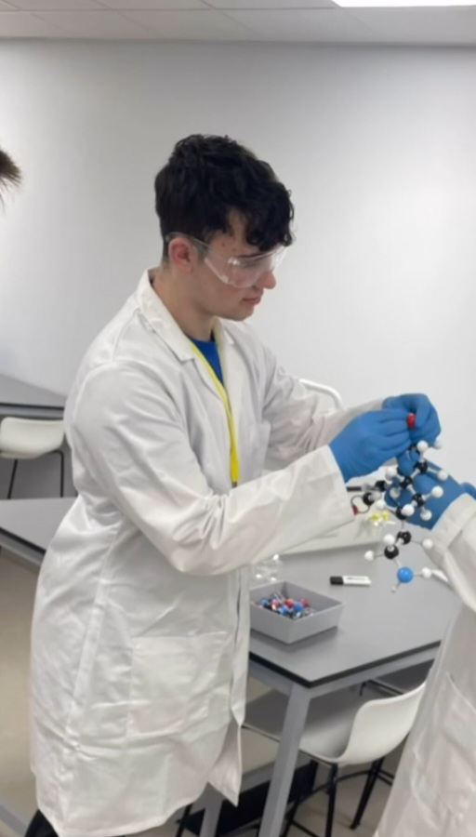

Slide 15

45 days placement across the two years
Find your own placement and NCD will visit and approve this
NCD directed placement in a pre-approved company

Slide 16

Future Occupations:
Medical Laboratory Assistant;
Biology, Chemical, or Physics Laboratory Technician;
Pharmacy Technician;
School/College Laboratory Technician;
Research Technician…

Slide 17

Progression:
Higher Apprenticeship;
HNC/HND;
Foundation Degree;
Bachelors Degree;
Masters Degree.
University campus visits to be organised as part of the T Level studies

Slide 18
What qualifications do you need?
T Level Health
Maths & English: Grade 4 or above
Sciences: Grade 4 or above
Grade 4 or above for other GCSE’s
T Level Science
Maths & English: Grade 5 or above
Sciences: Grade 6
Grade 4 or above for other GCSE’s

Slide 19
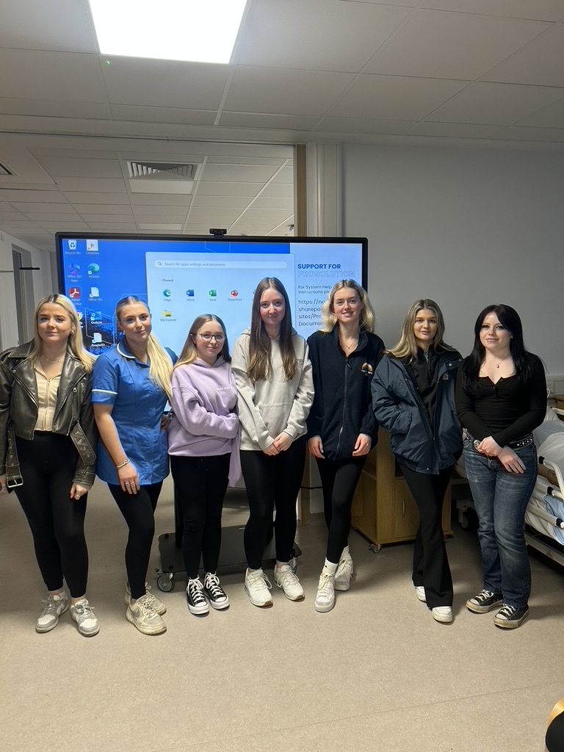







Our students that have progressed to university regularly come back and support our current students.

Slide 20
Activities and Opportunities at New College Durham?

Slide 21

Services available at NCD:
Cafeteria;
Restaurant;
Costa;
Starbucks;
Gym;
Hair and Beauty salons;
Library;
Digital Learning area;
Our Facilities

Slide 22

Additional educational support…
Personal Learning Coaches;
Student Support Services, for learning support and additional exam arrangements;
ASC (Advice, support, careers);
Free student bus passes;
Free college meals (upon application)
Student bursary (upon application)
Students

Slide 23

Activities and Opportunities
Fund raising for charities
T Level students did a phenomenal job at raising money and collecting Christmas presents for one of the local Women’s Refuges

Slide 24
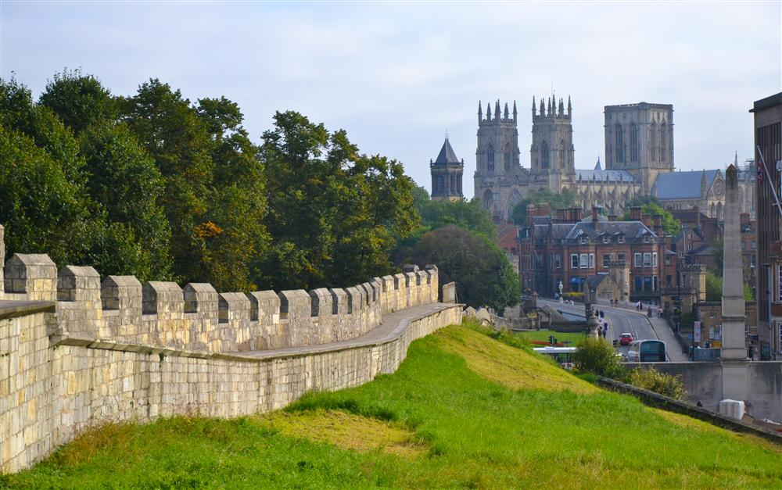
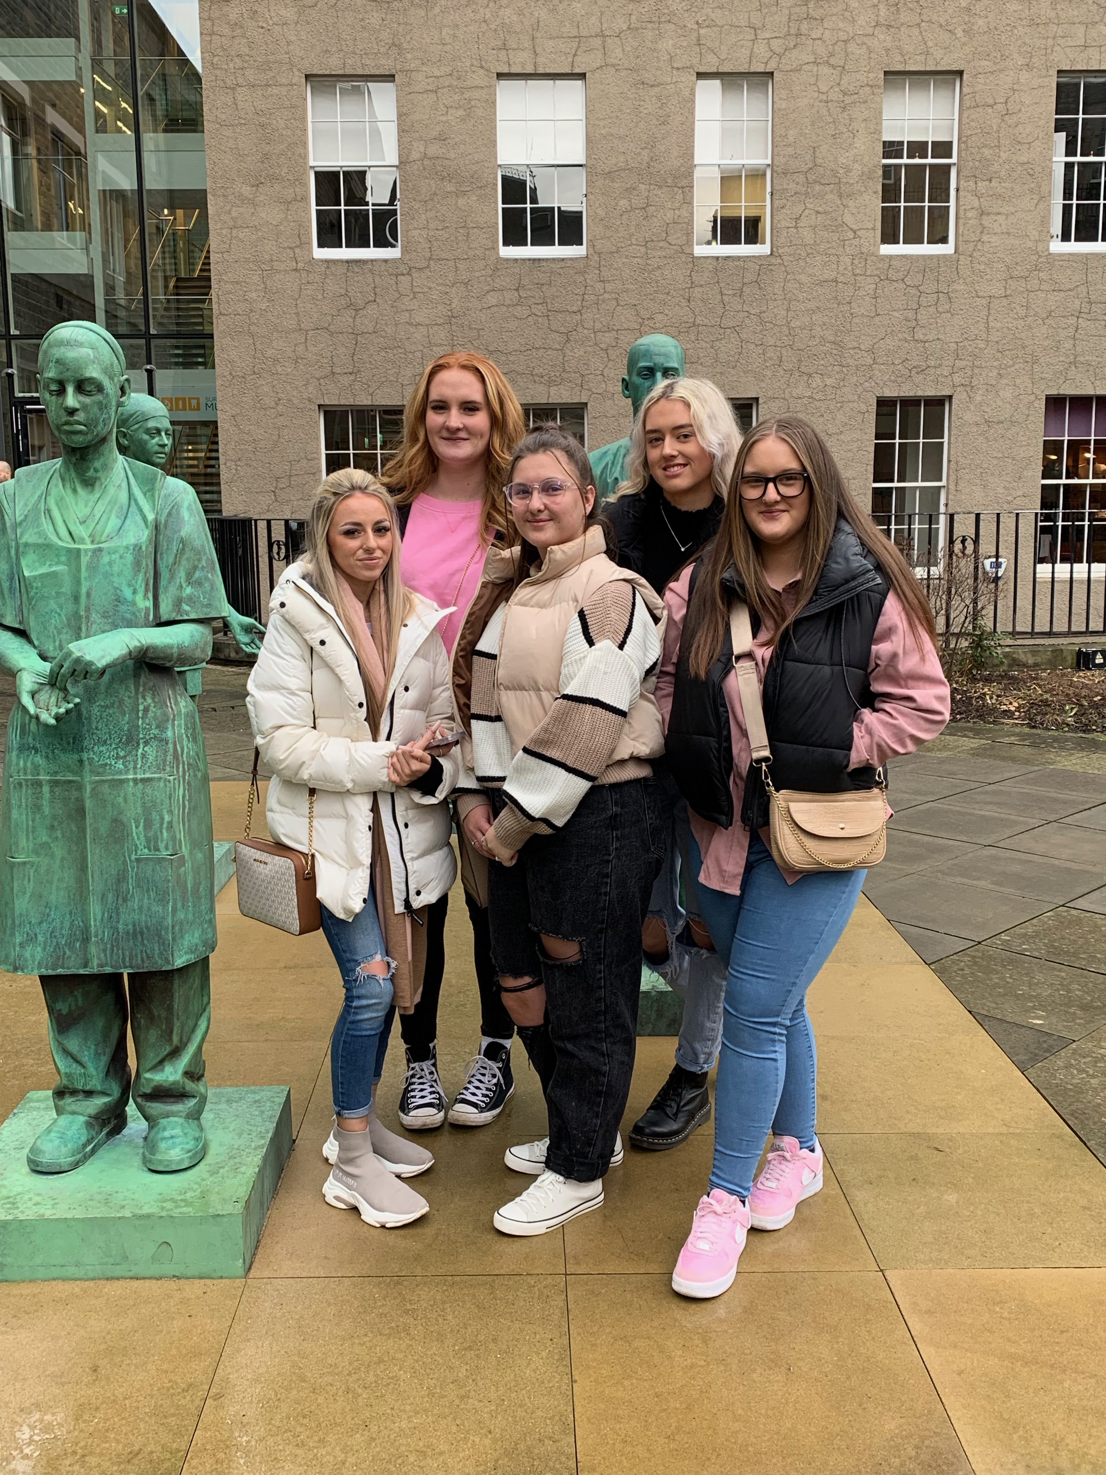
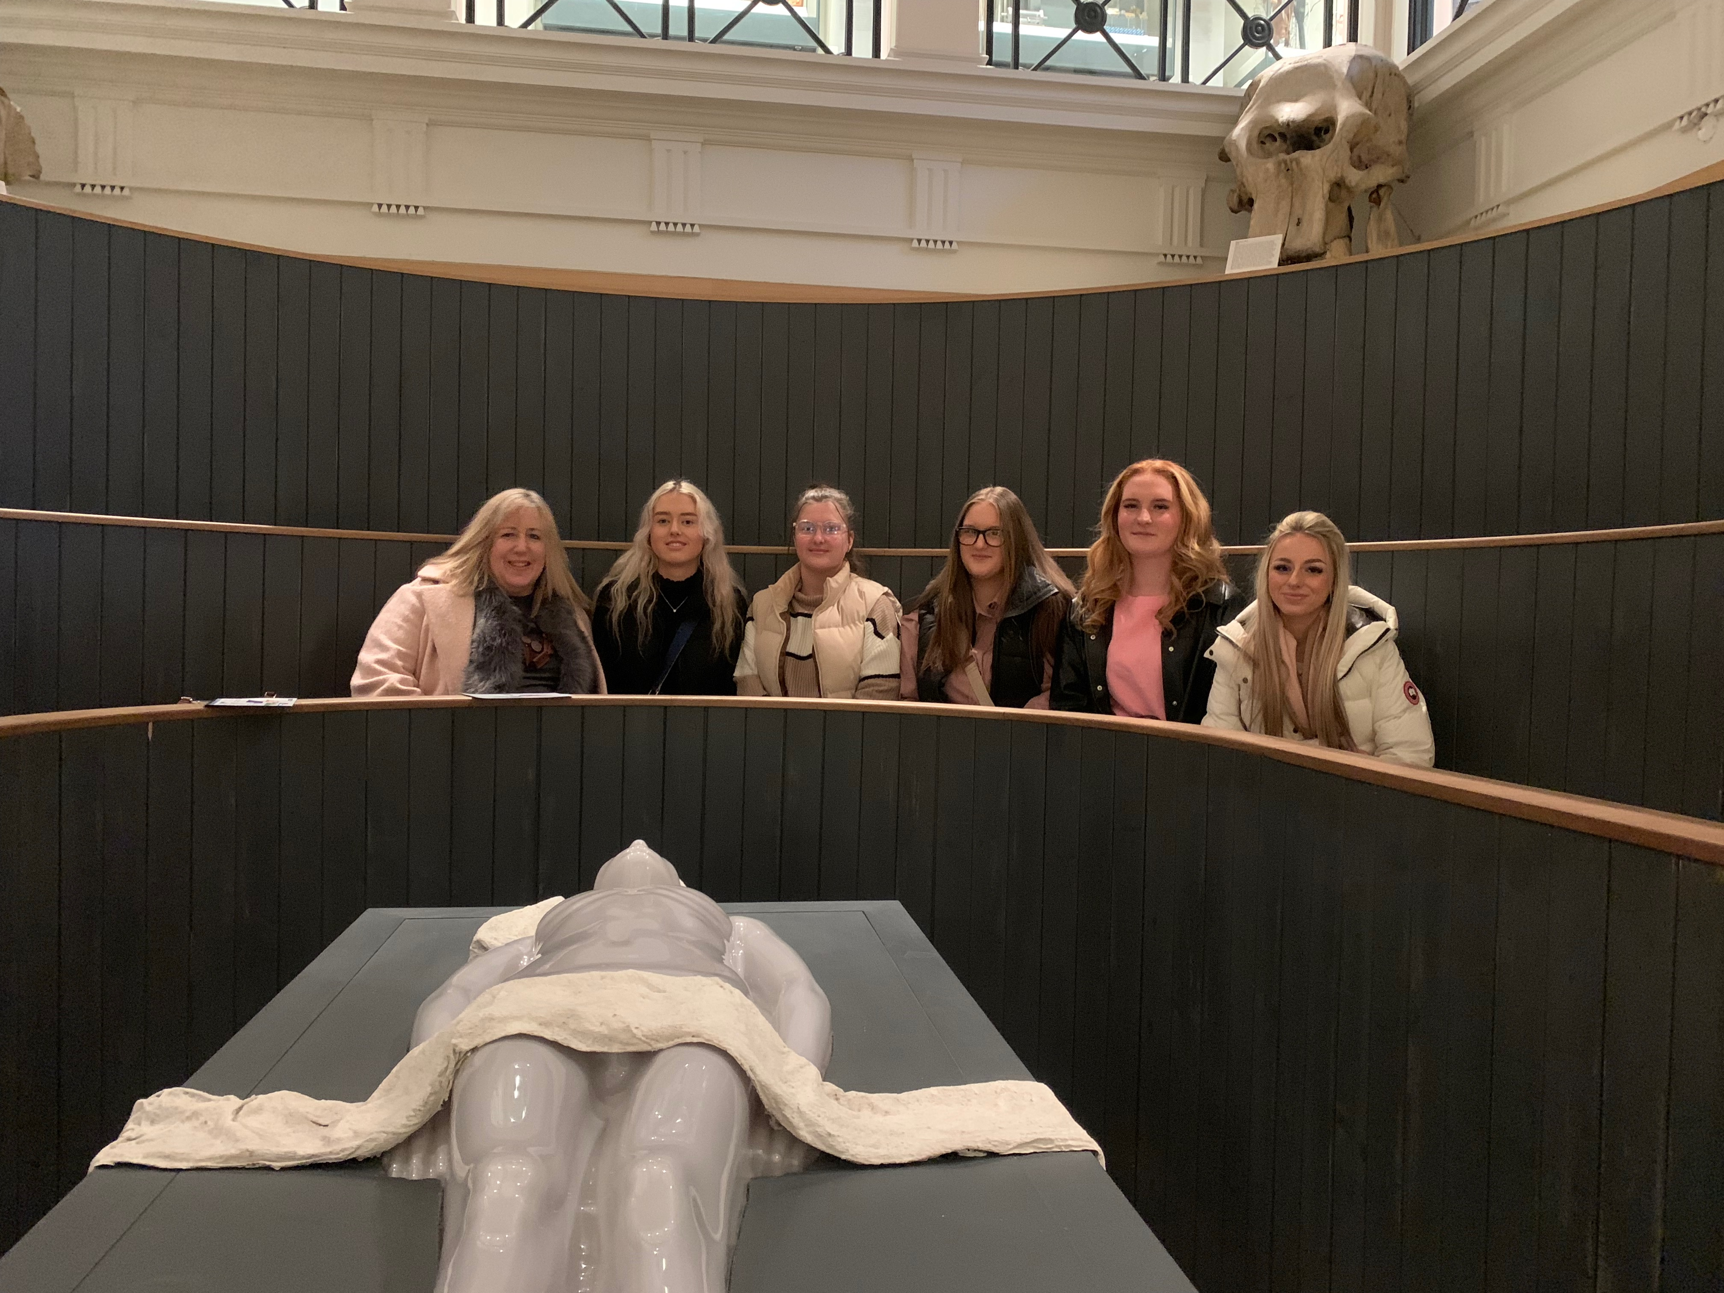
Activities and Opportunities
Day Trips
Surgeons Hall Museum – Edinburgh
York

Slide 25





Activities and Opportunities
Future planning:
Educational 2-day trip to Amsterdam
Corpus Museum
of the Human Body
Vreugdehof Care Home for
people with dementia
Anne Frank House

Slide 26


What happens now:
Welcome Day Fest & Enrolment end of August
Bring in your GCSE results
You will:
Meet your tutor and T Level group
Be given a timetable
Given a lot of this information again!
Commence the course on the 2nd September

Slide 27


Slide 28


Slide 29


Slide 30


Slide 31
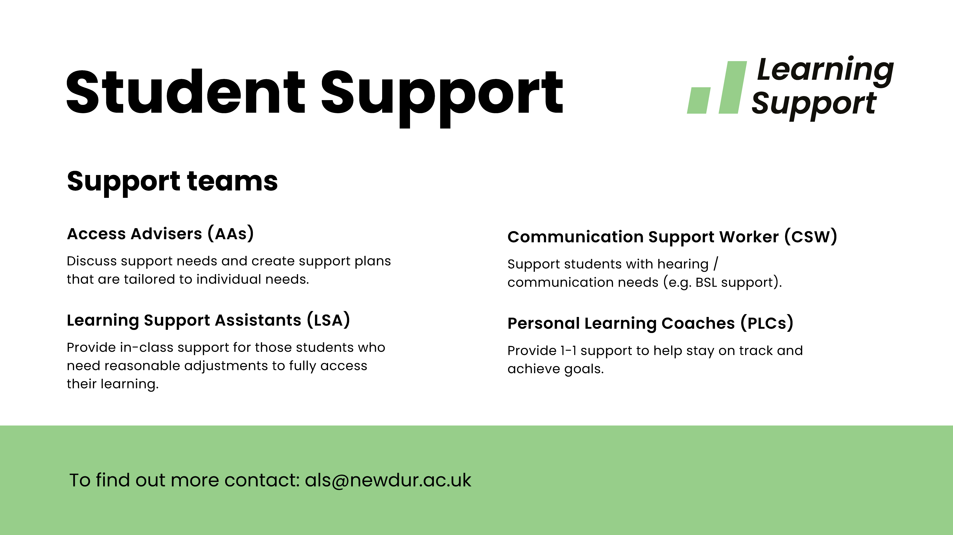

Slide 32


Slide 33
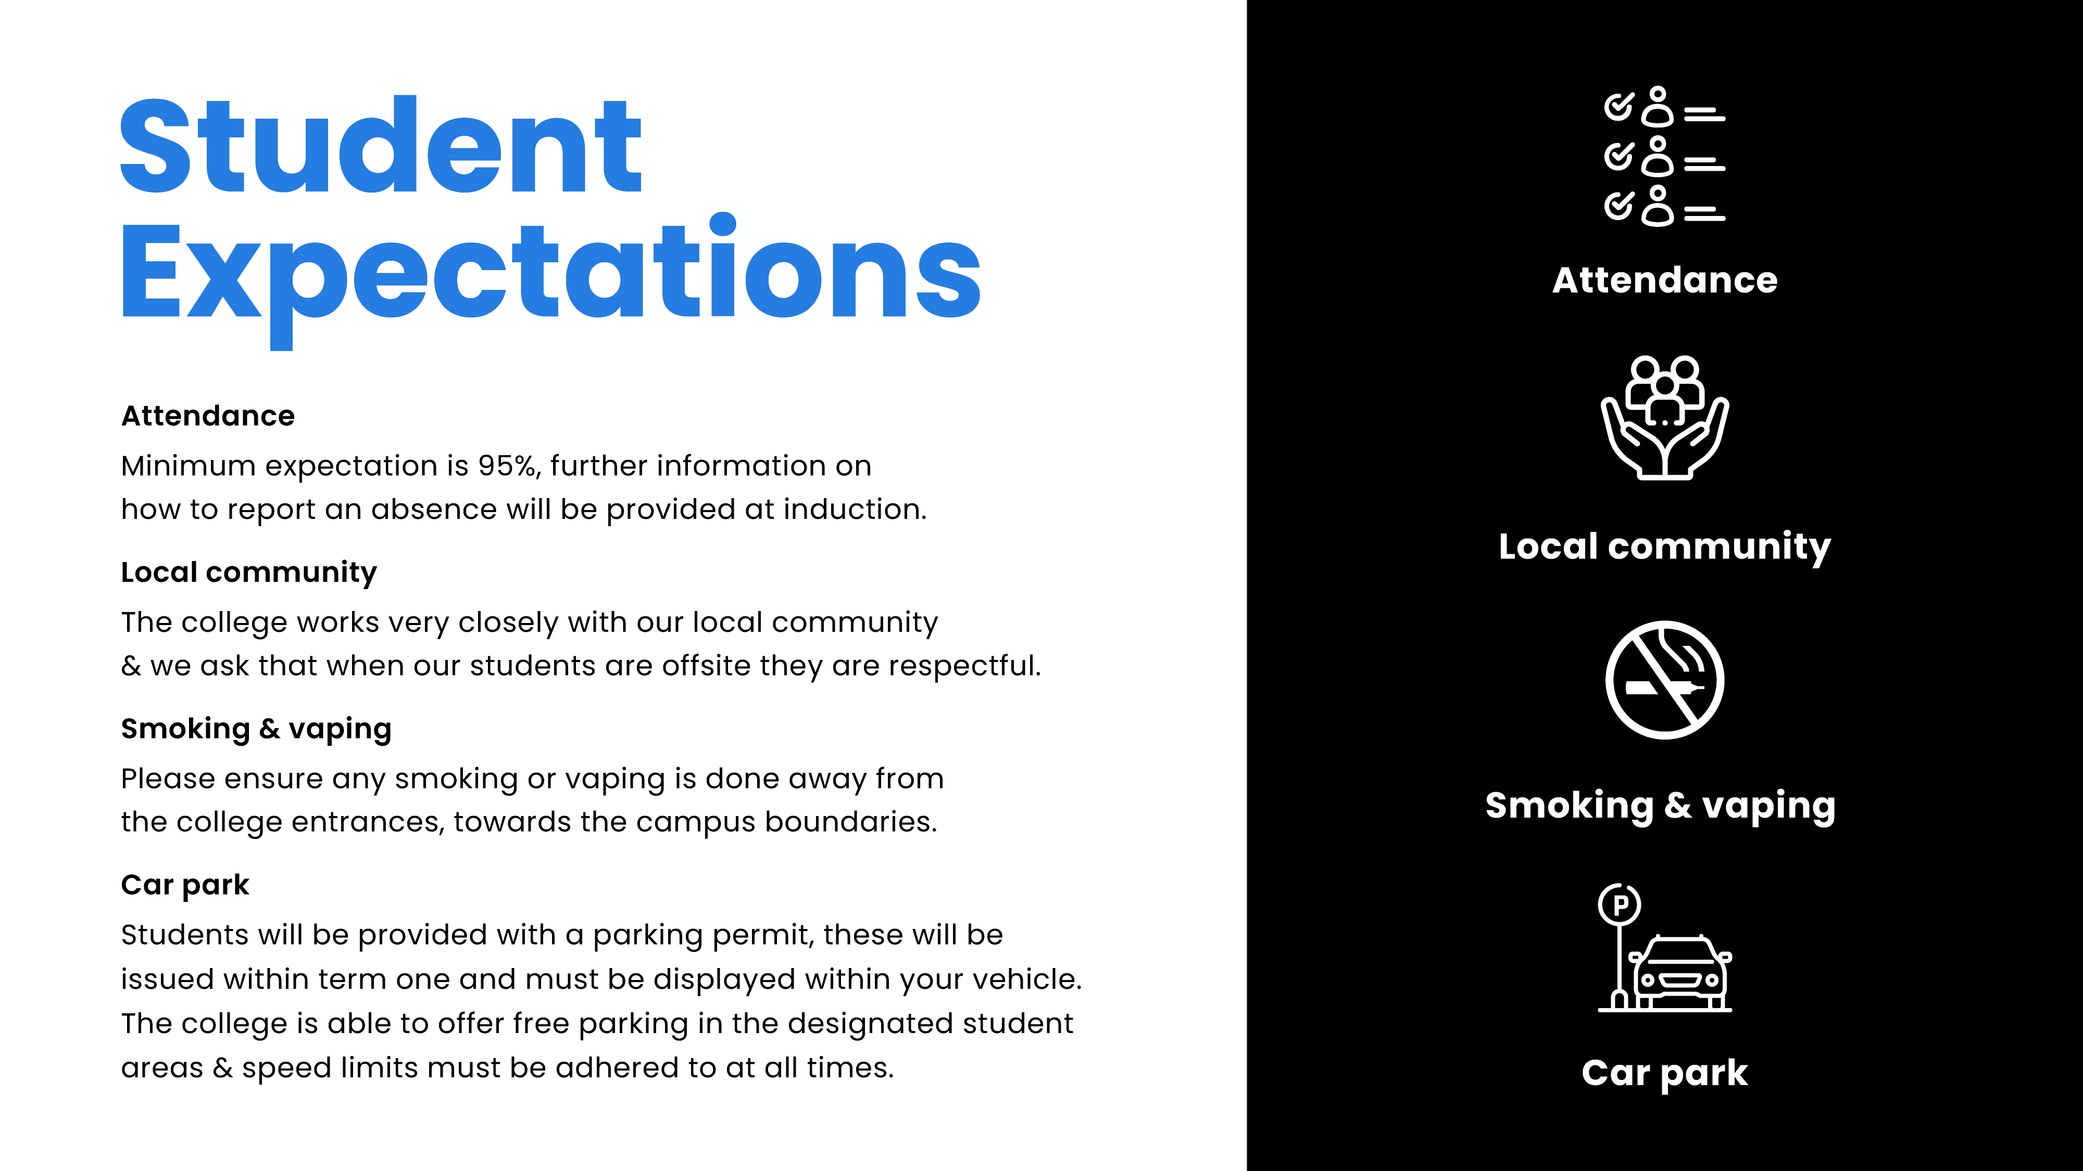

Slide 34
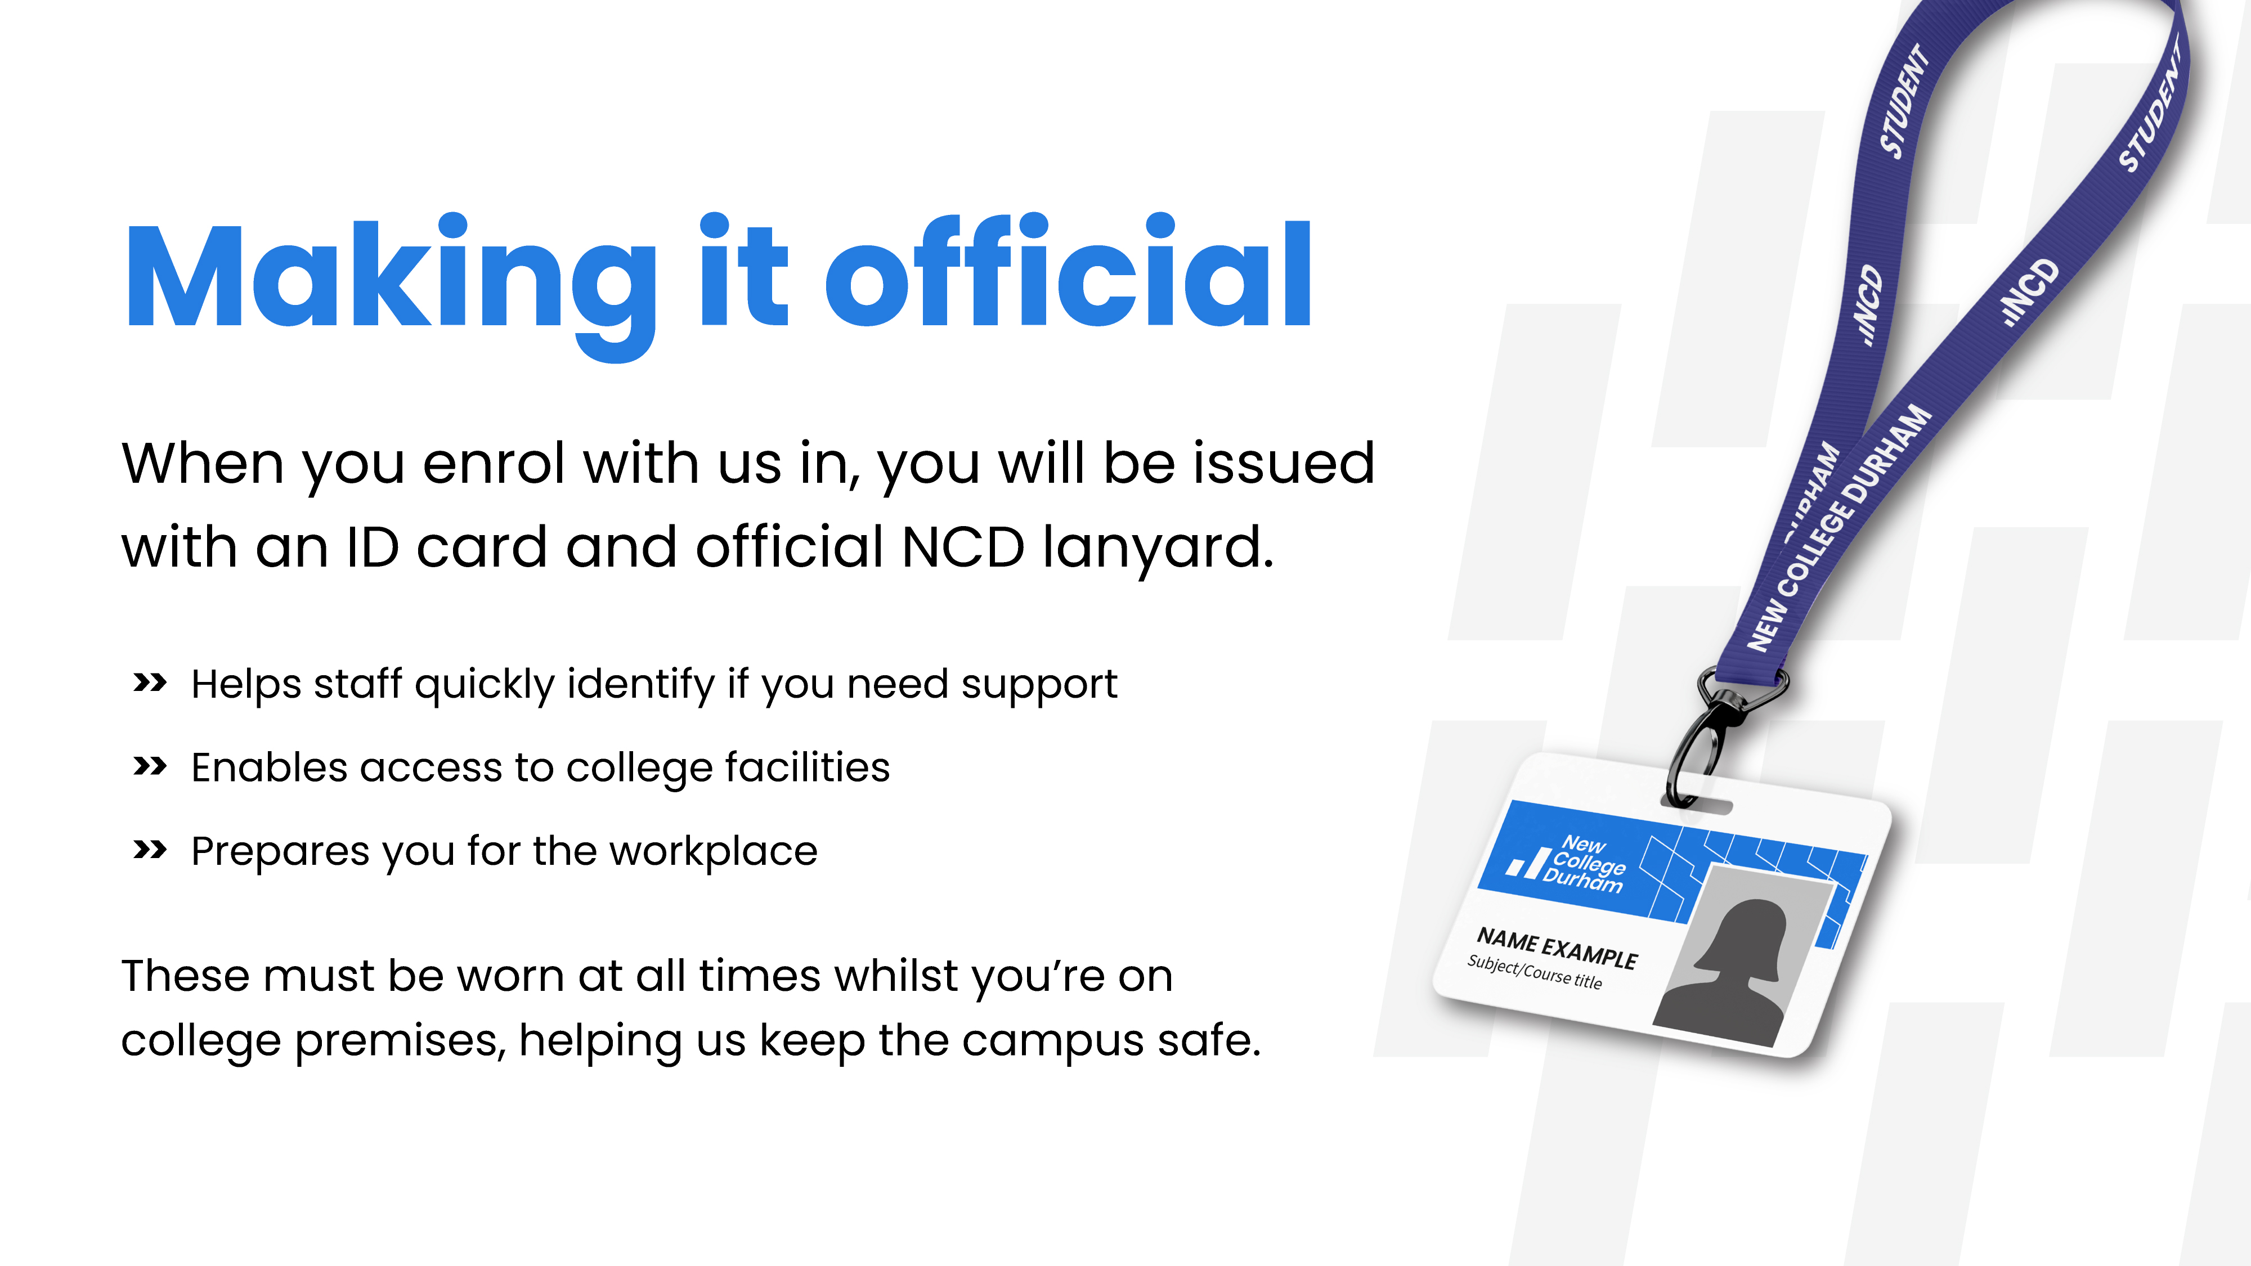

Slide 35
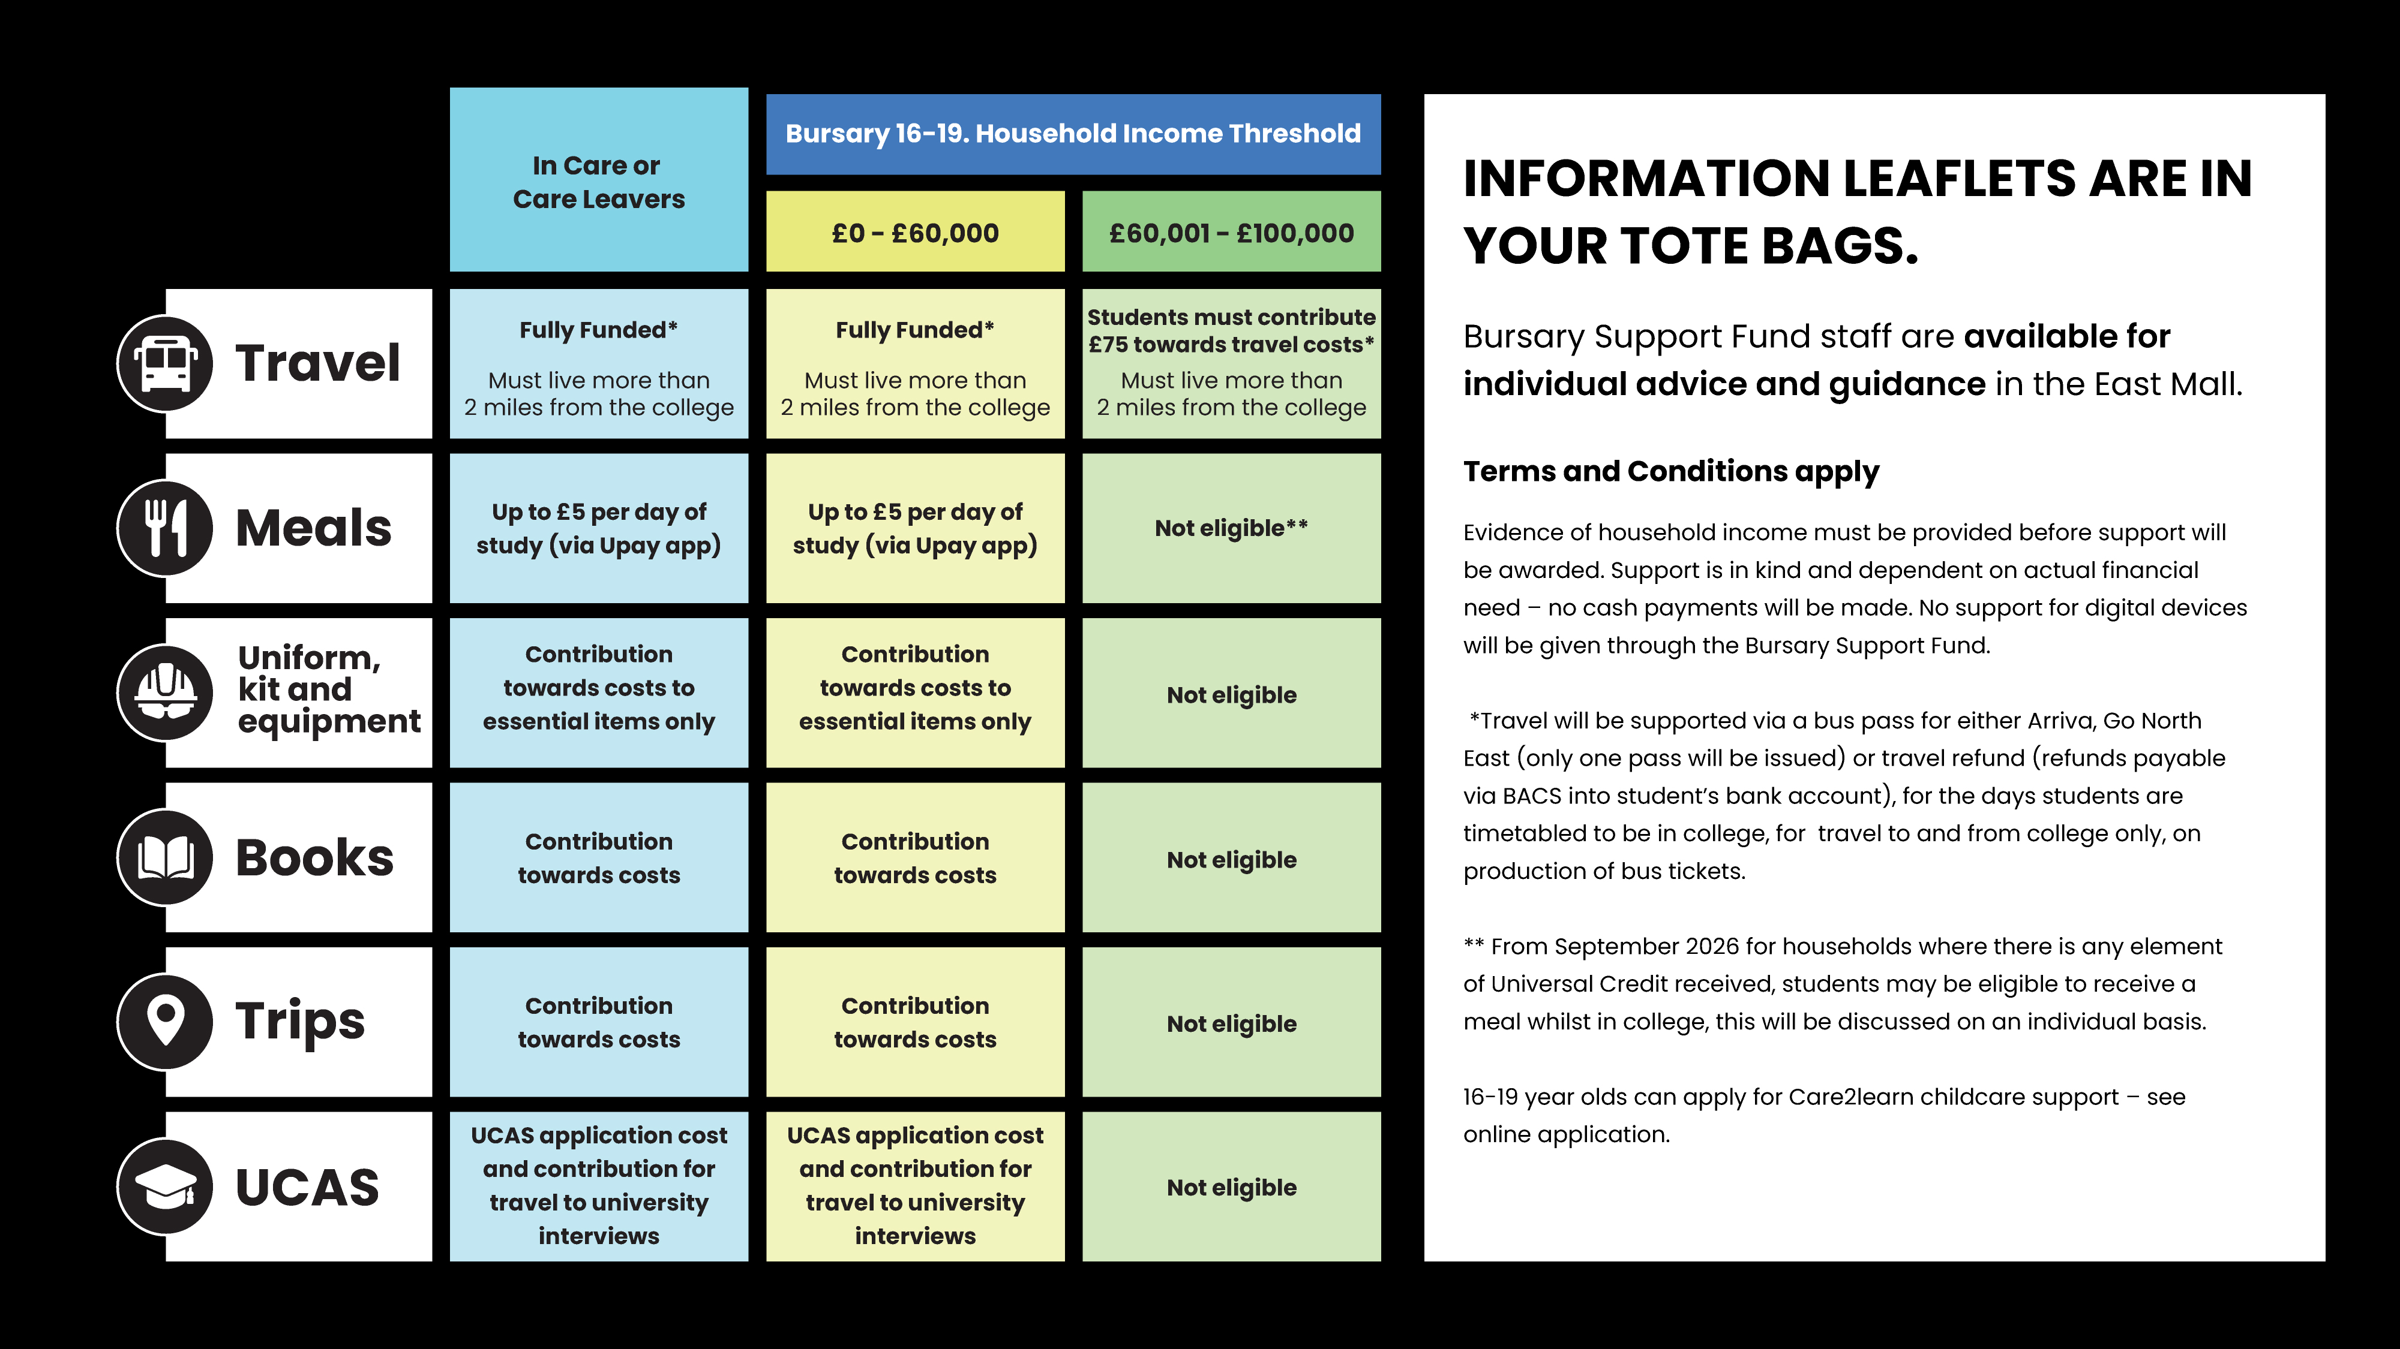

Slide 36


Slide 37


Slide 38


Slide 39


