Slide 1


WELCOME TO THE NEXT LEVEL

Slide 2


Slide 3
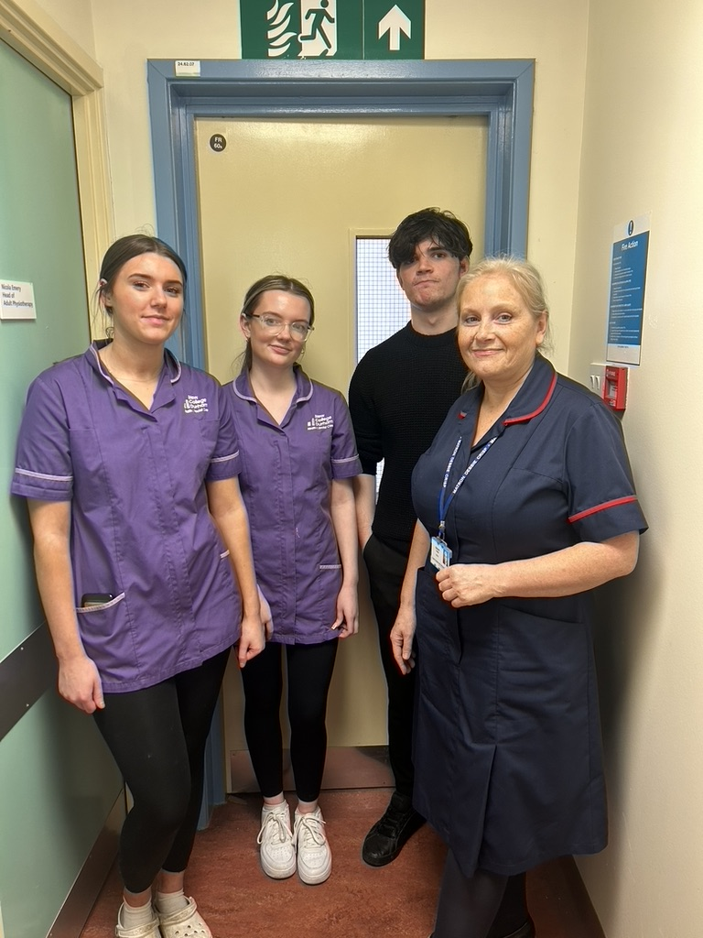


Why choose T Levels?
T Levels are a Government driven 2-year nationally recognised qualification.
One T Level is equivalent to 3 A levels
Accepted by Universities
(T Level Merit = 120 UCAS points)
Designed and endorsed by employers
Includes a 45-day (315 hours) industry placement to help you learn what a real career is like and prepare you for employment

Slide 4



Slide 5

How are T Levels different to apprenticeships?
Apprenticeships are typically 80% on-the-job and 20% in the classroom, and are more suited to those who are ready to enter the workforce at age 16
T Levels involve more classroom study than apprenticeships and prepare students for work, further training or further study.

Slide 6
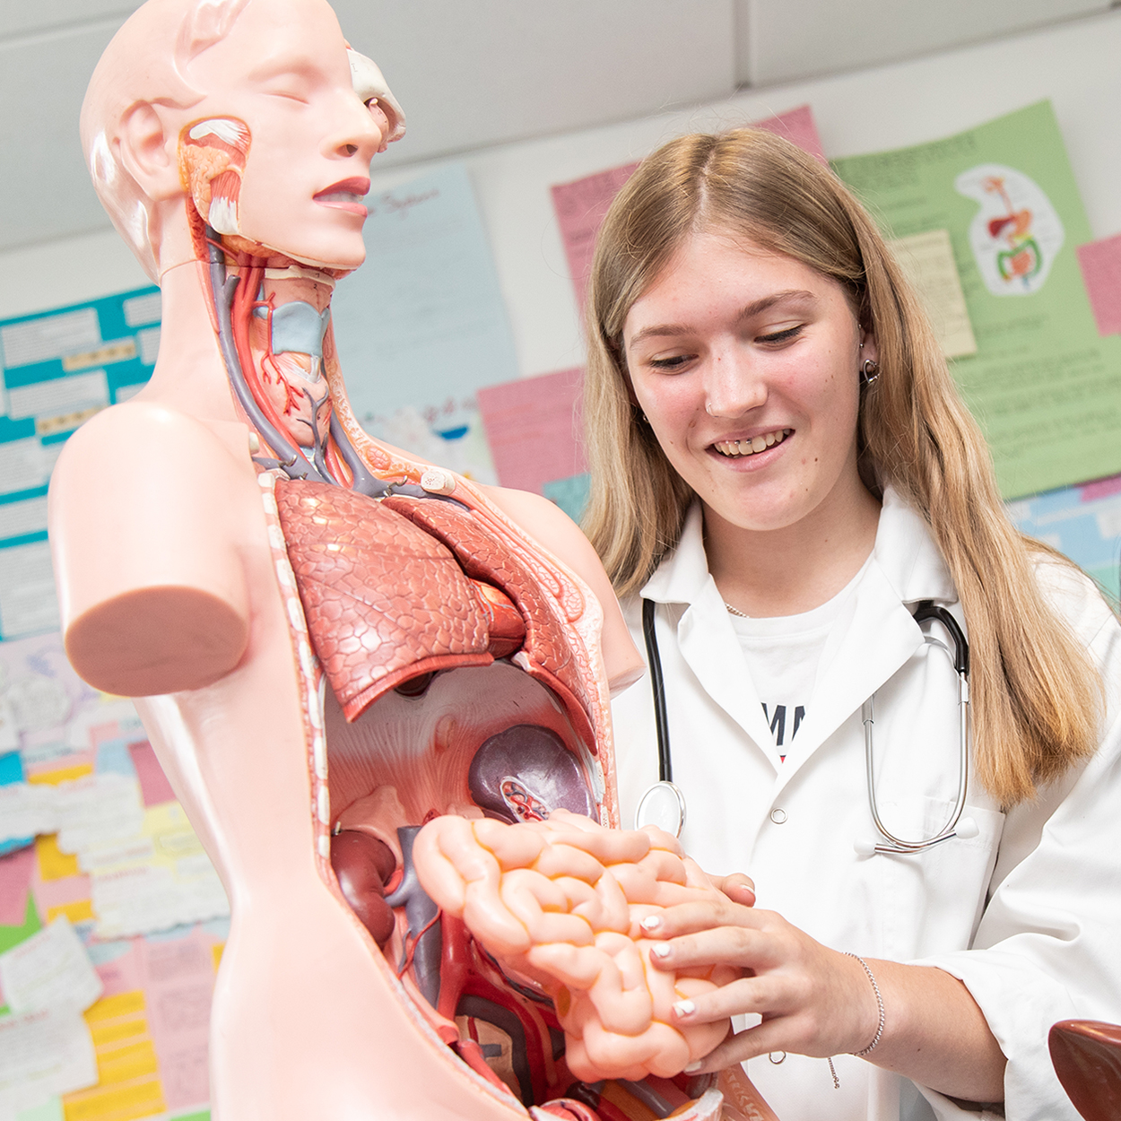

T Level Health
Year 1
Core A: Health ​
Core B: Science ​
Work Placement x1 day per week​

Slide 7

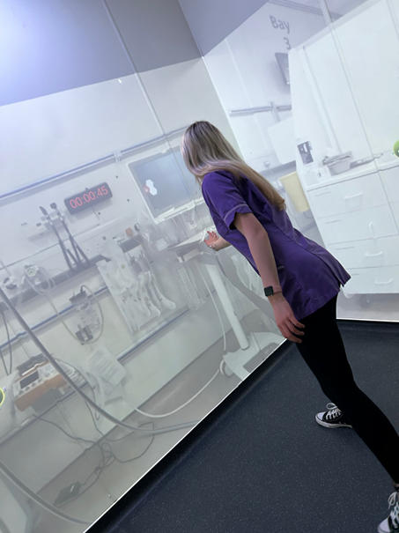
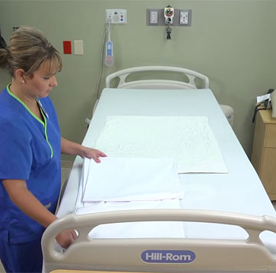
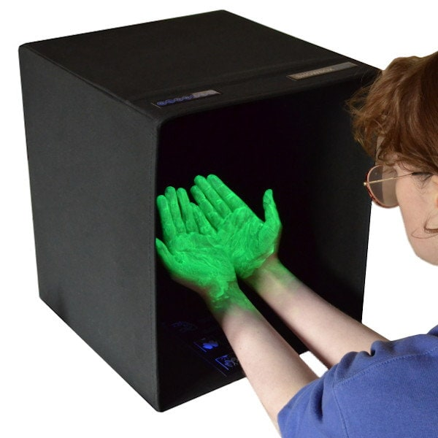
Year 1 Core Subject – Health
What do you study?
Apply
theory to practice
in our simulated environments
Theory
Working in the Health & Science Sector
The Healthcare Sector
Health & Safety
Managing information & data
Good scientific & clinical practice
Person-centred care
Health & Wellbeing
Safeguarding
Infection prevention and control

Slide 8

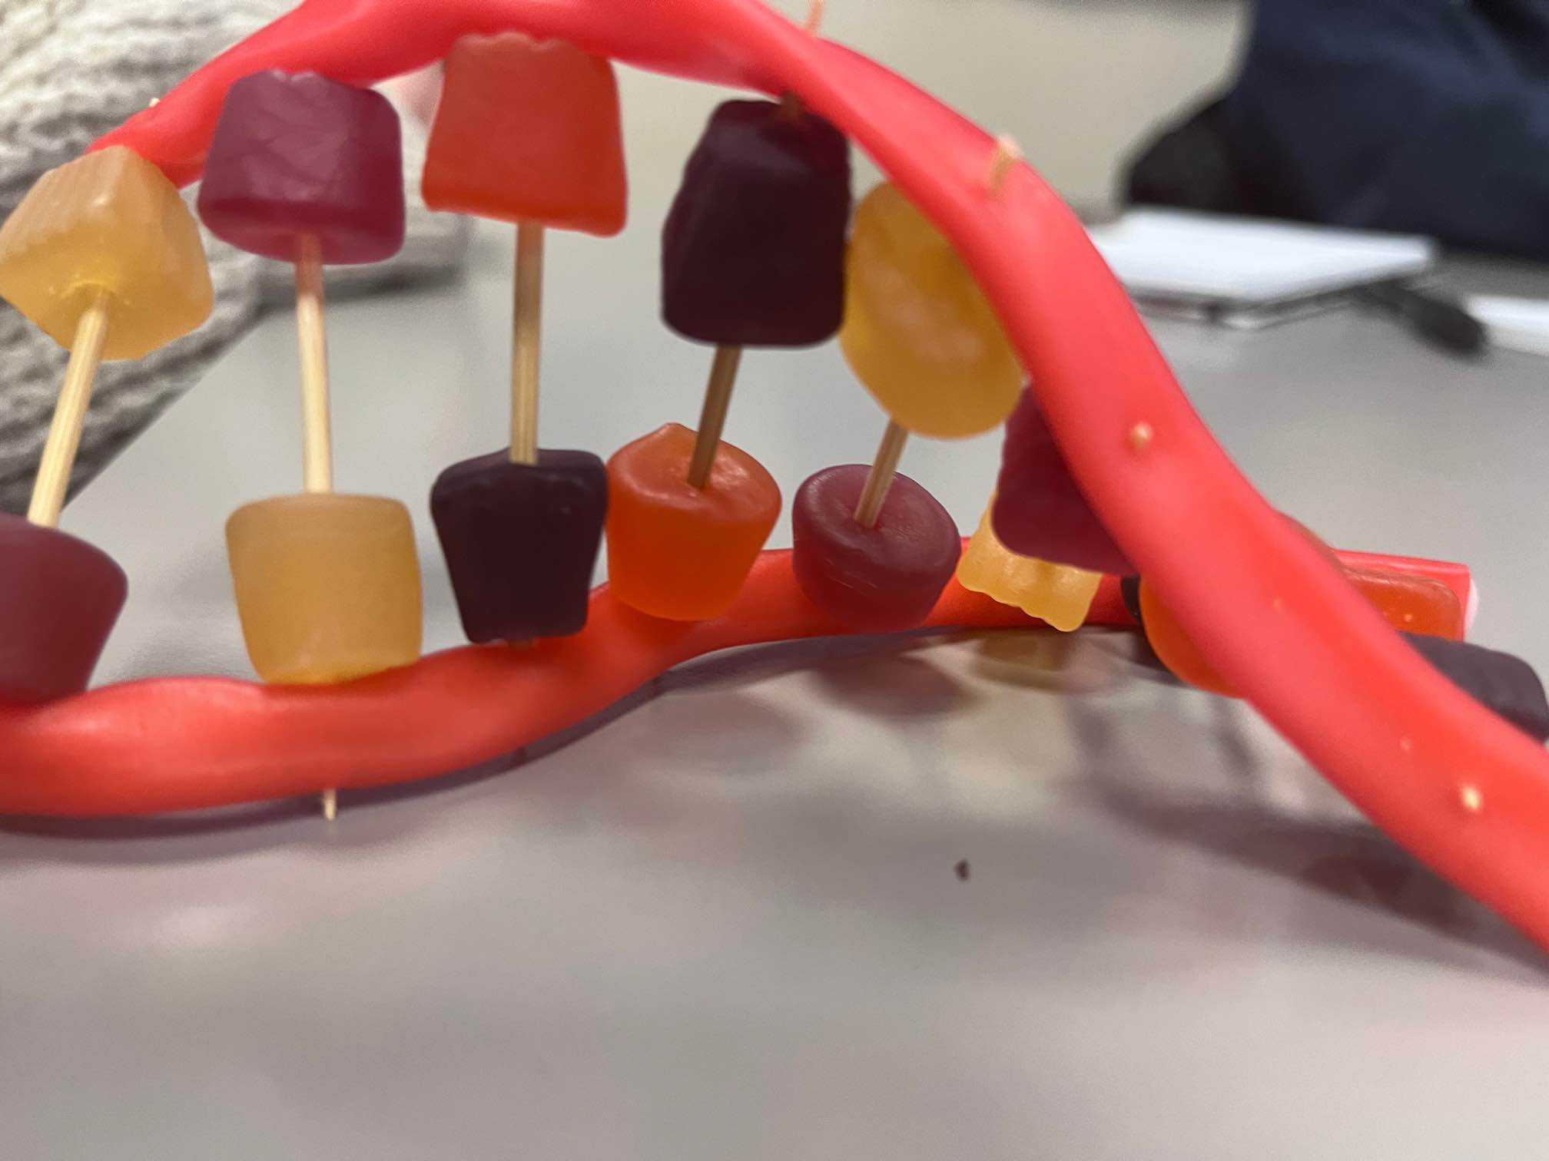

Year 1 Core Subject – Science
What do you study?
Theory
Core science concepts
  Biology
  Chemistry (small amount)
  Medical physics (small amount)
Further Science Concepts in Health

Slide 9
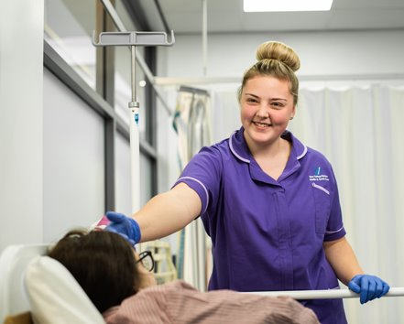
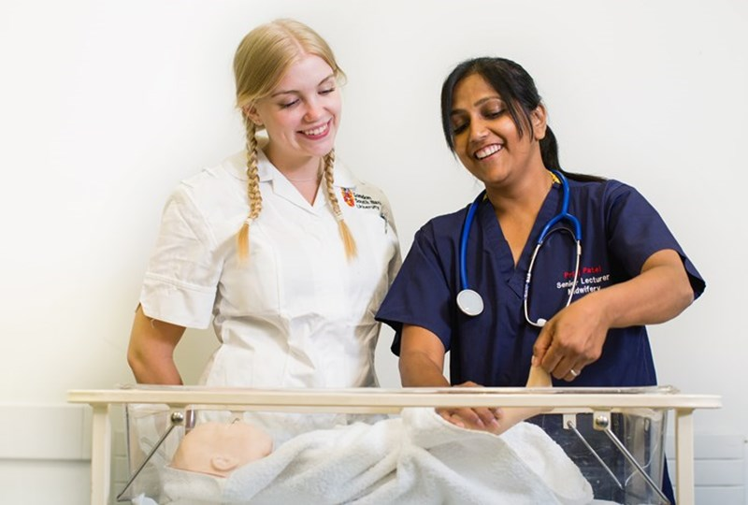

Year 2:
Occupational Specialism Pathways
Supporting the Adult Nursing Team
Supporting the Midwifery Team
Supporting the Mental Health Team

Slide 10
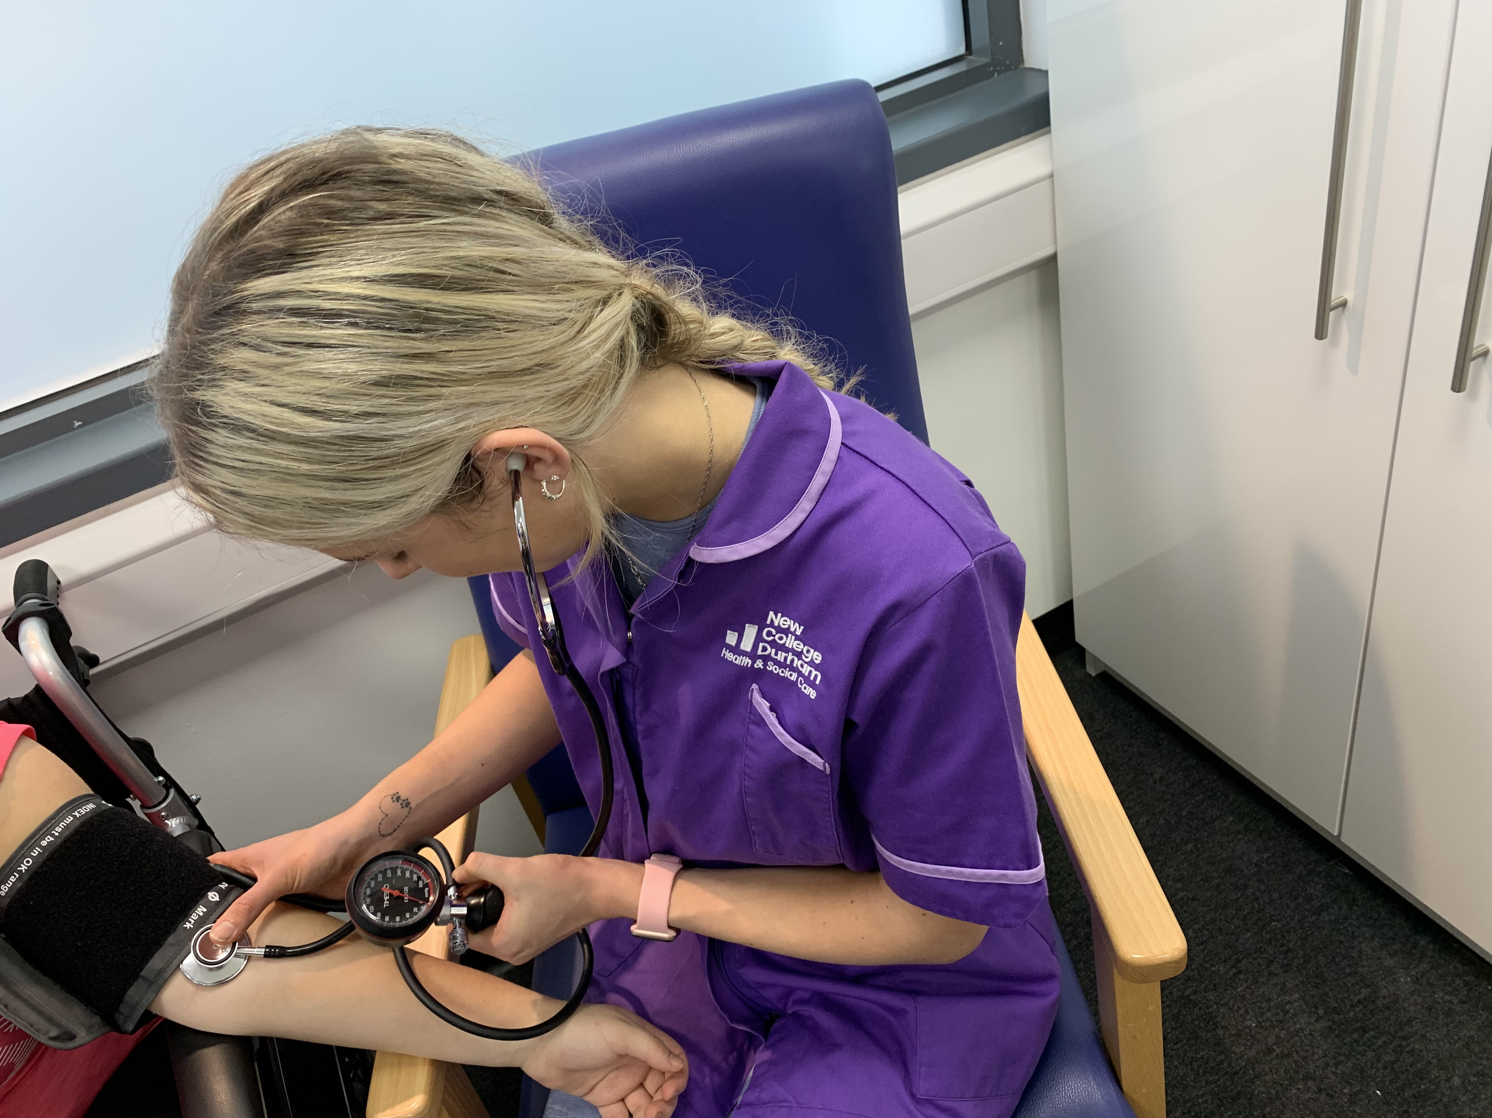
Supporting the Adult Nursing Team
Exploring subjects such as:
Clinical tasks in Nursing
Physiological Measurements
Skin Integrity
Infection Prevention & Control
Supporting individuals to meet activities of daily living
Supporting nutrition & hydration

Slide 11
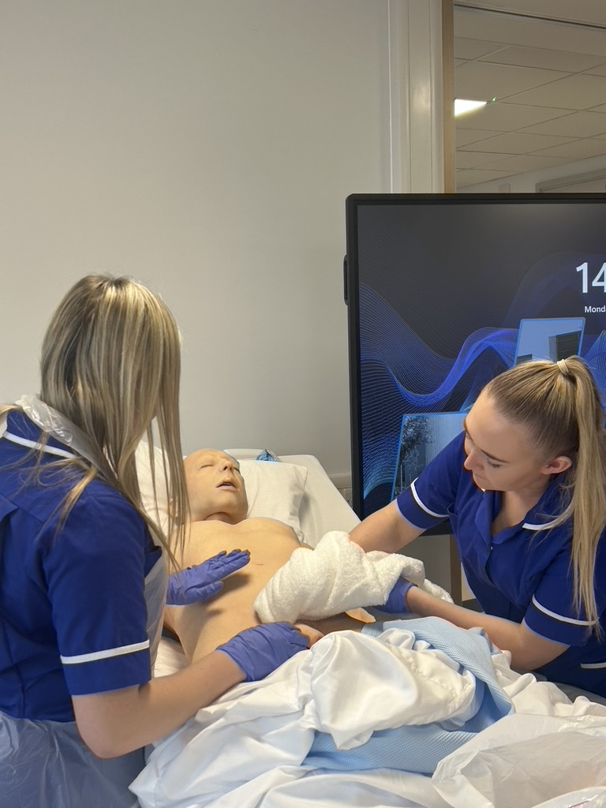
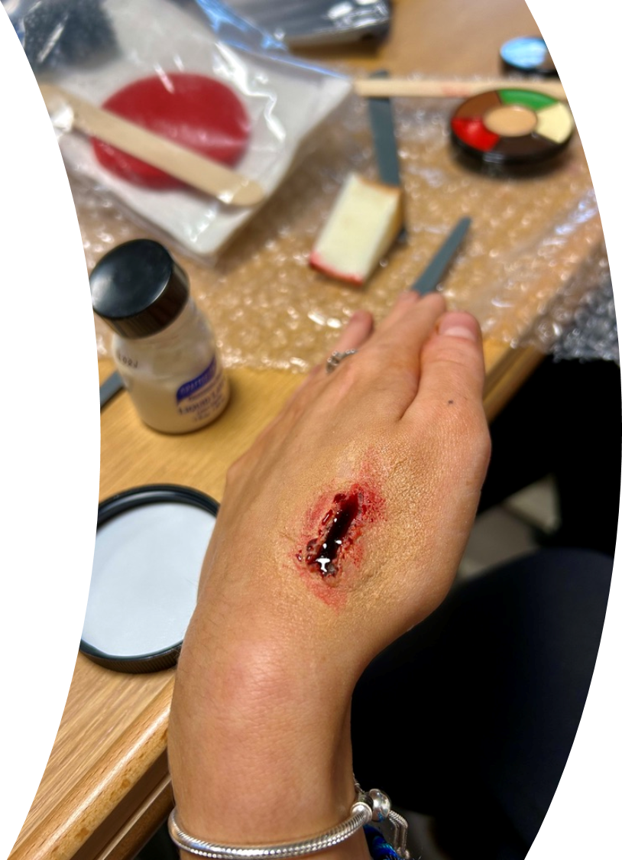
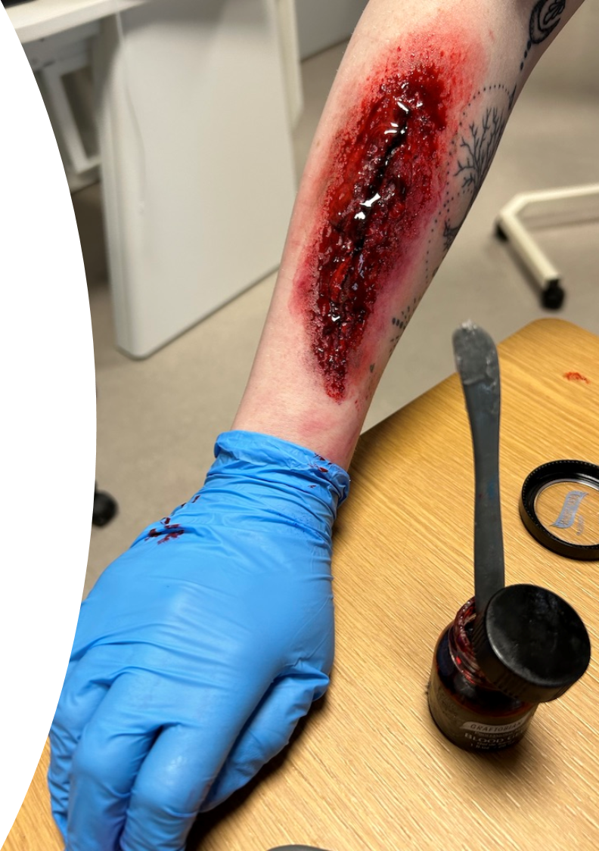
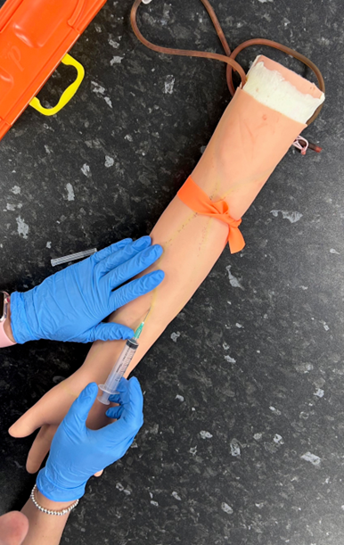
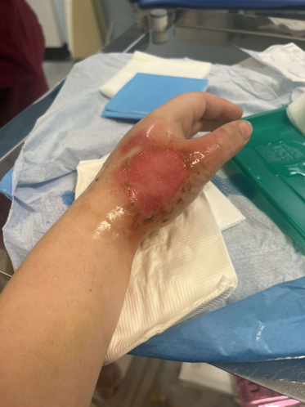
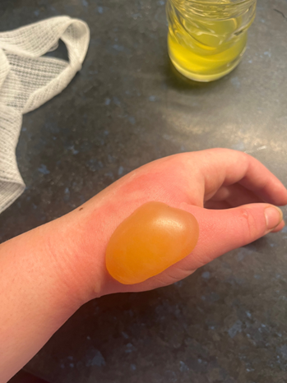
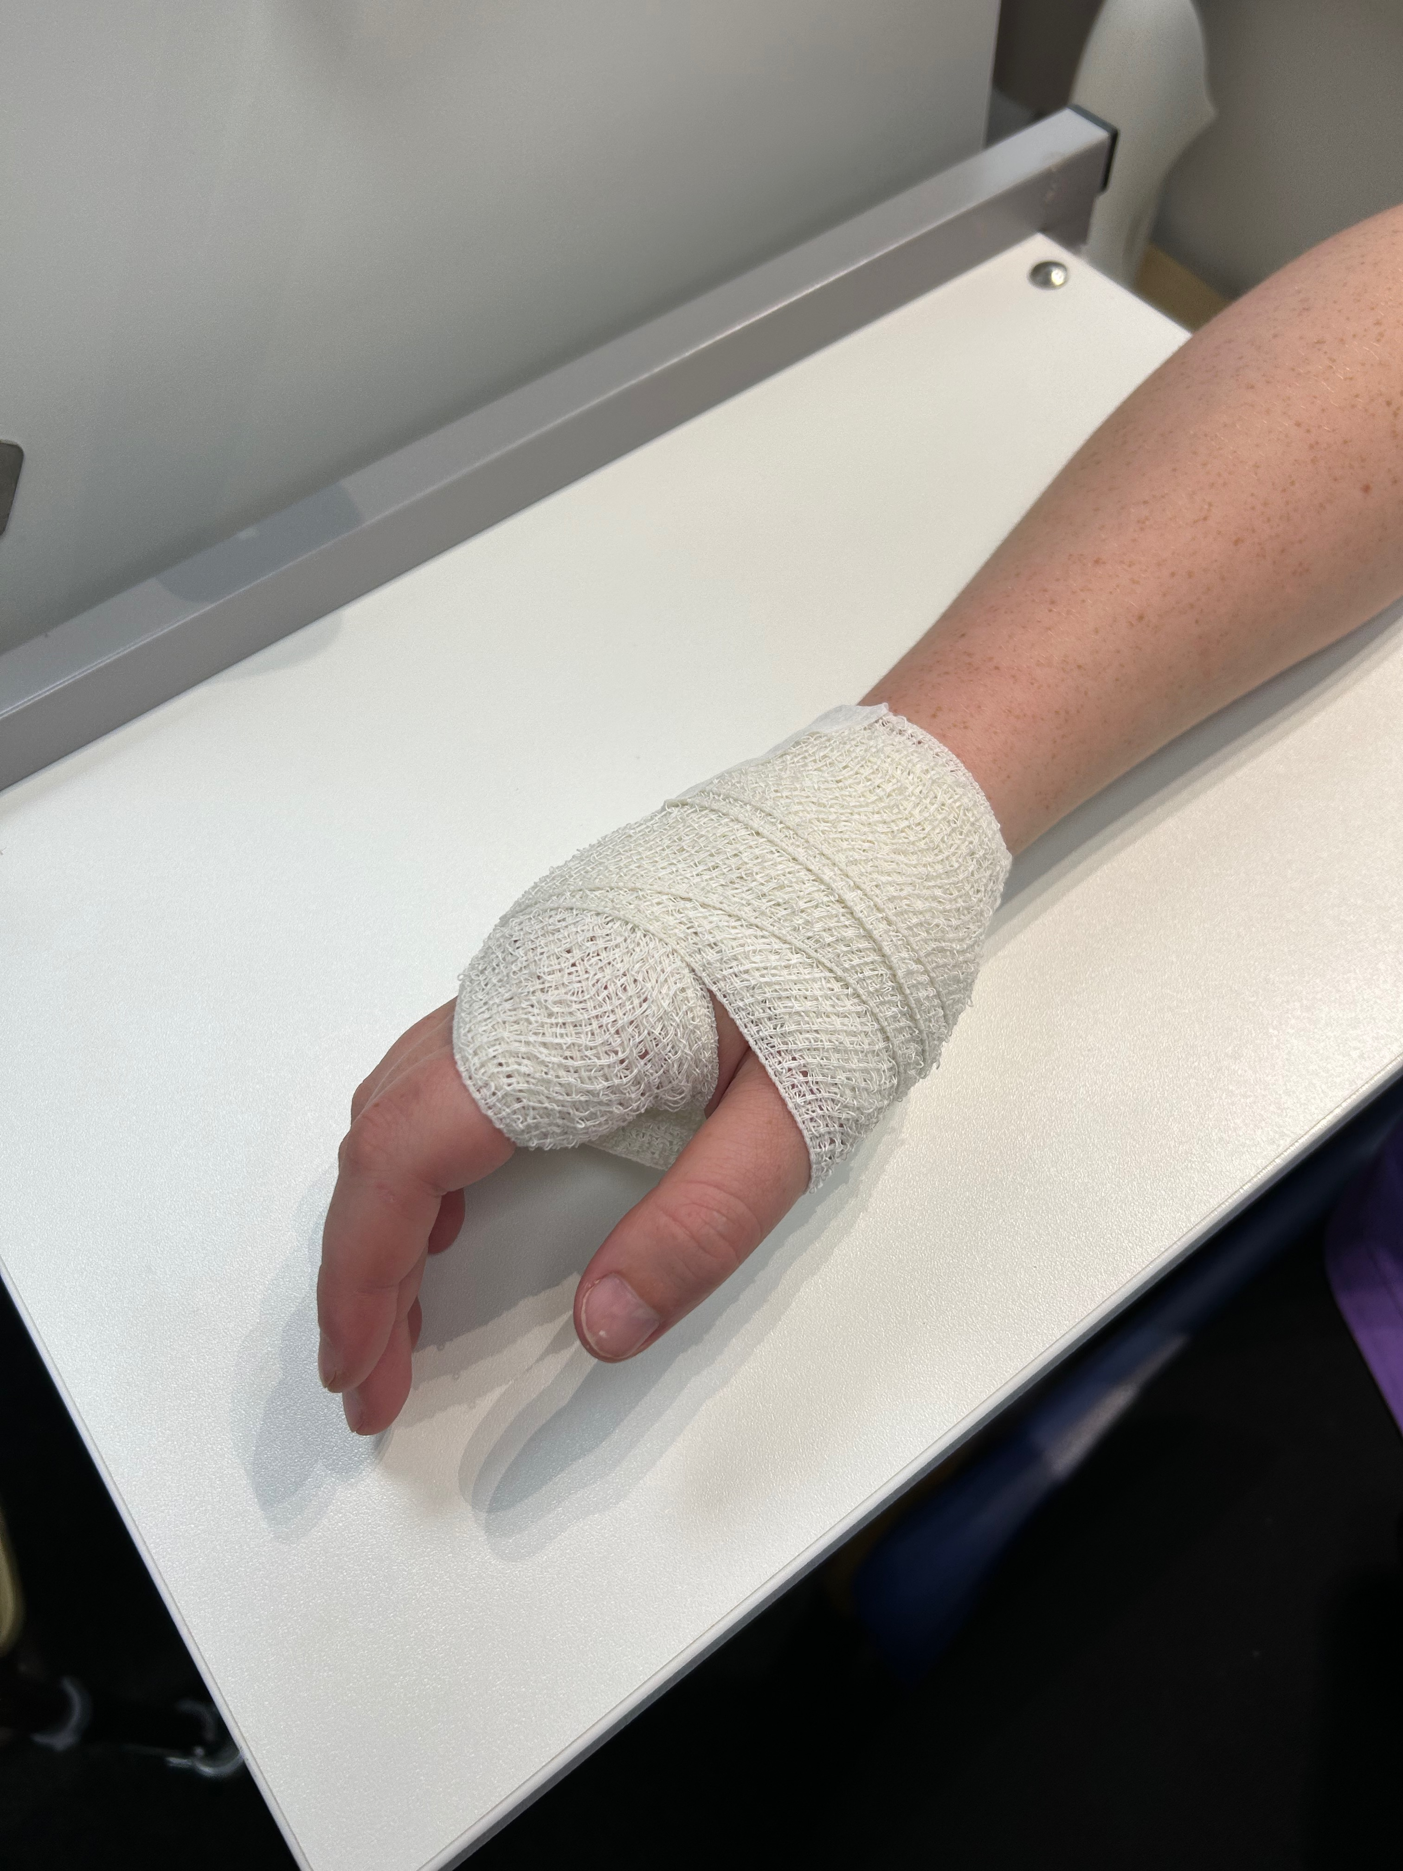
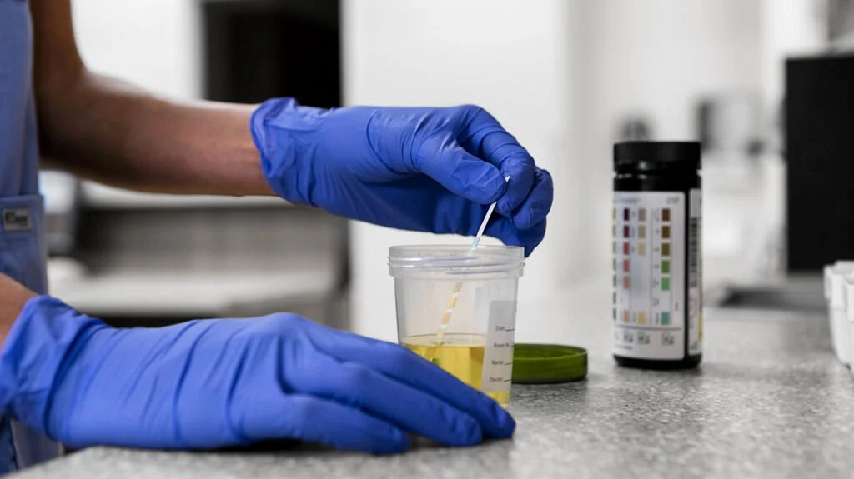
Supporting the Adult Nursing Team

Slide 12
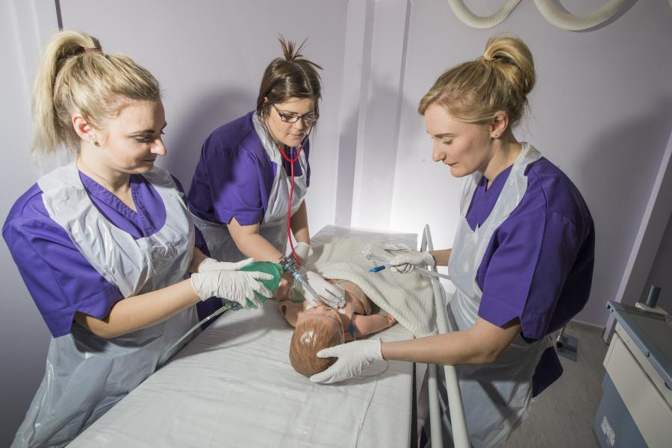
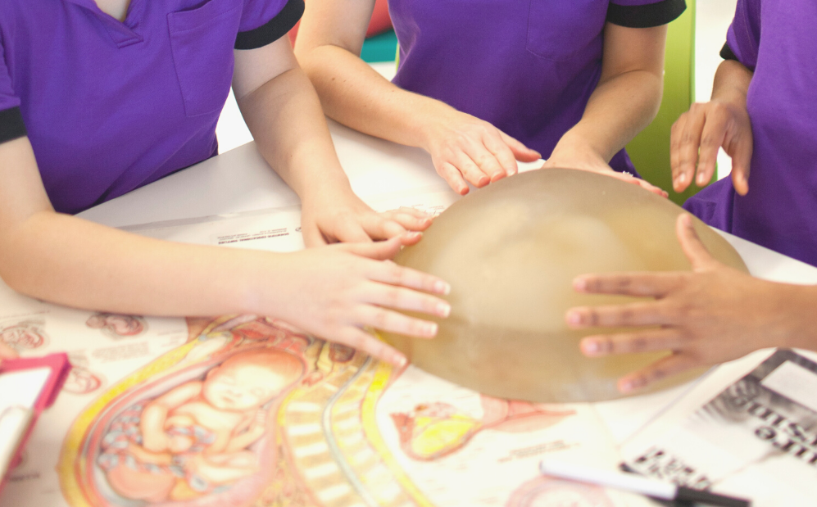

Supporting the Midwifery Team
Exploring subjects such as:
Clinical tasks in Maternity
Care for mothers and support to parents at all stages
Care of newborn babies
Undertaking observations and measurements

Slide 13
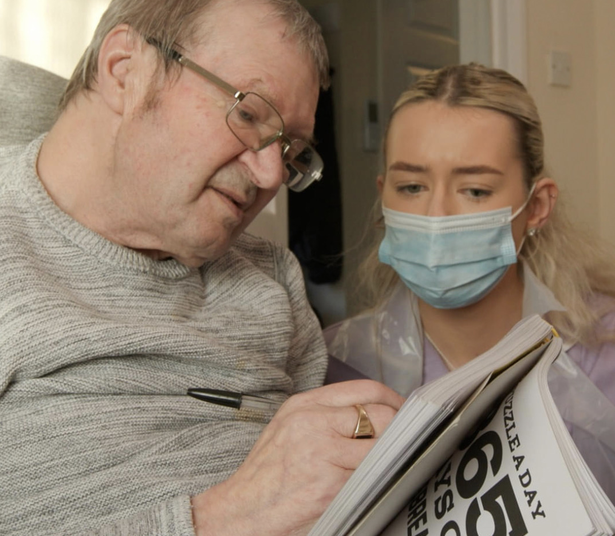
Supporting the Mental Health Team
Exploring subjects such as:
Care and support to individuals with Mental Health conditions
Assist with Mental Health tasks and therapeutic interventions
Promote mental wellbeing

Slide 14
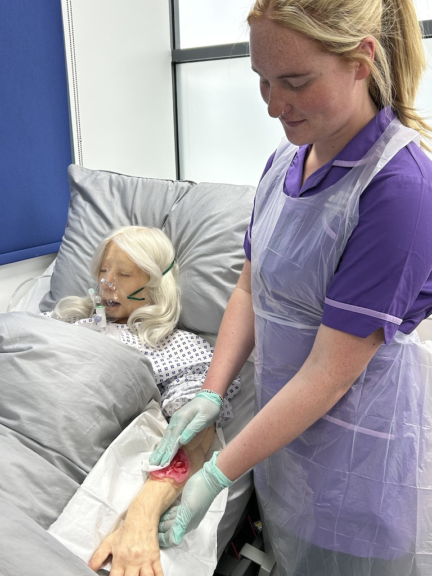
Occupational Specialism Core: Supporting Healthcare
Alongside each Occupational Specialism runs the Supporting Healthcare pathway
Mandatory content to cover:
Assist with an individual’s overall care and needs to ensure comfort and wellbeing
Assist registered health professionals with clinical or therapeutic tasks & interventions
Undertake a range of physiological measurements

Slide 15
​​T Level Health | Content ​​ | Assessment method​​ | Grading ​​
Year 1 Core ​ Section A: ​ Health​ ​ Section B: ​ Science | Knowledge and understanding of context, concepts, theories and principles​​ ​​ Ability to apply core knowledge and skills​​ ​​ | 2x externally assessed exams Employer Set Project​​ ​ ​ ​ | A* - E​​
Year 2: Occupational ​ Specialism​​ | Knowledge and skills needed for an industrial specialism ​ | Practical assessment Professional discussion Written assessment​​ | Distinction* Distinction​​ Merit​​ Pass​​
On completion of 2-year course |  |  | Distinction* Distinction Merit Pass

Slide 16


Industry Placement
Mandatory part of T Level programme – You cannot pass course without it
Give students a valuable opportunity to put theory into practice, develop their technical skills & become more employable
45-day industry placement (315 hours)
NHS hospitals, clinics, laboratories
GP Surgeries
Day Units
Domiciliary care
Residential care homes
District Nursing team
Nurseries
Schools
Day units
Podiatry

Slide 17


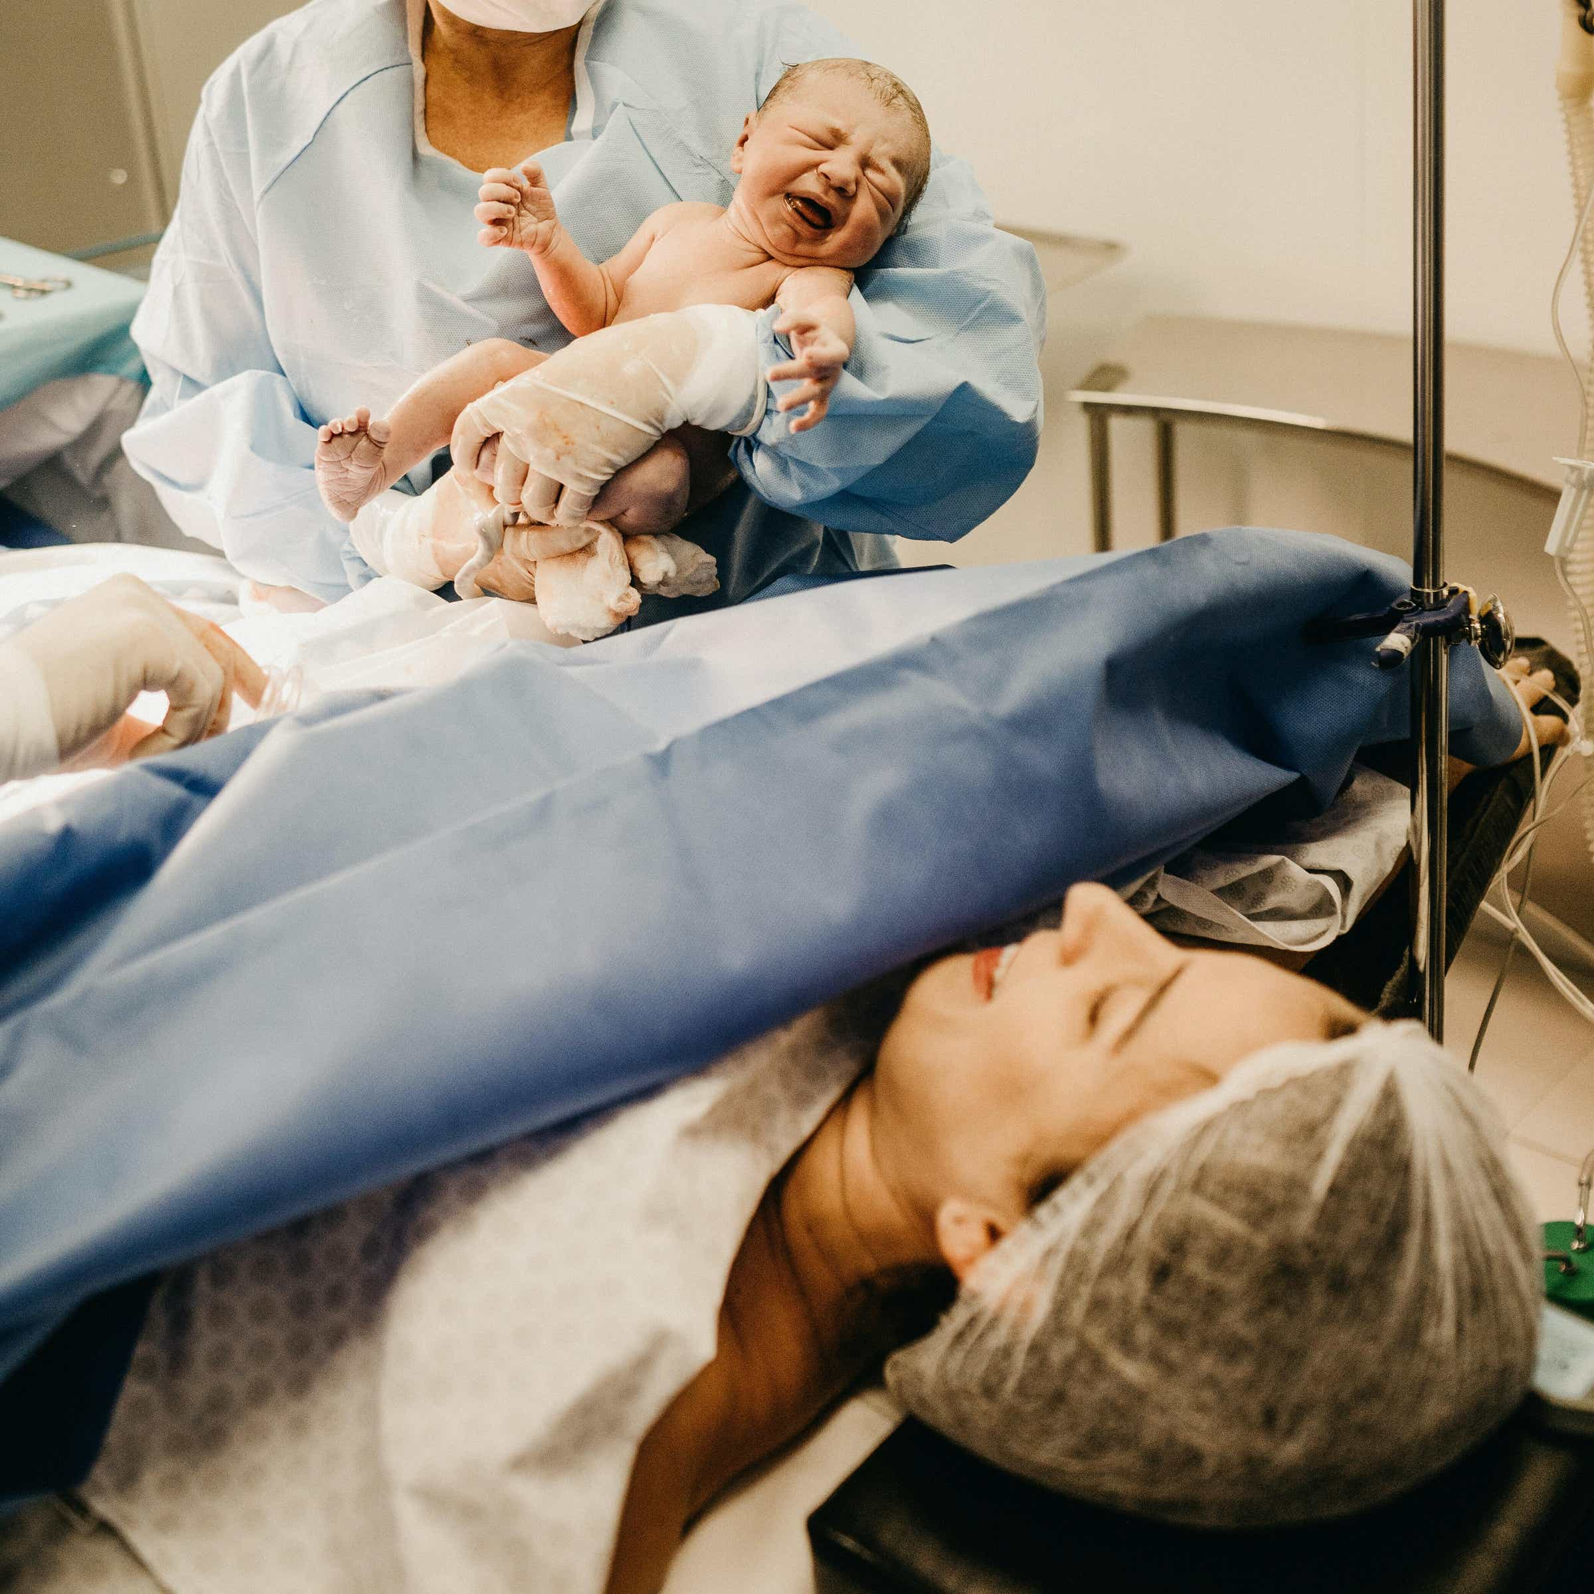
T-Level Health
Career pathways could be:
Health Care Assistant
Care Worker
Job role in the Health Sector
Adult Nurse Degree
Children Nurse Degree
Disability Nurse Degree
Mental Health Nurse Degree
Midwifery Degree
Allied Health Professional Degree
Paramedic Science
*Successful completion of the T Level will open the University doors – equivalent to 3 A levels
Routes: Employment Higher Education Higher Level Apprenticeships

Slide 18
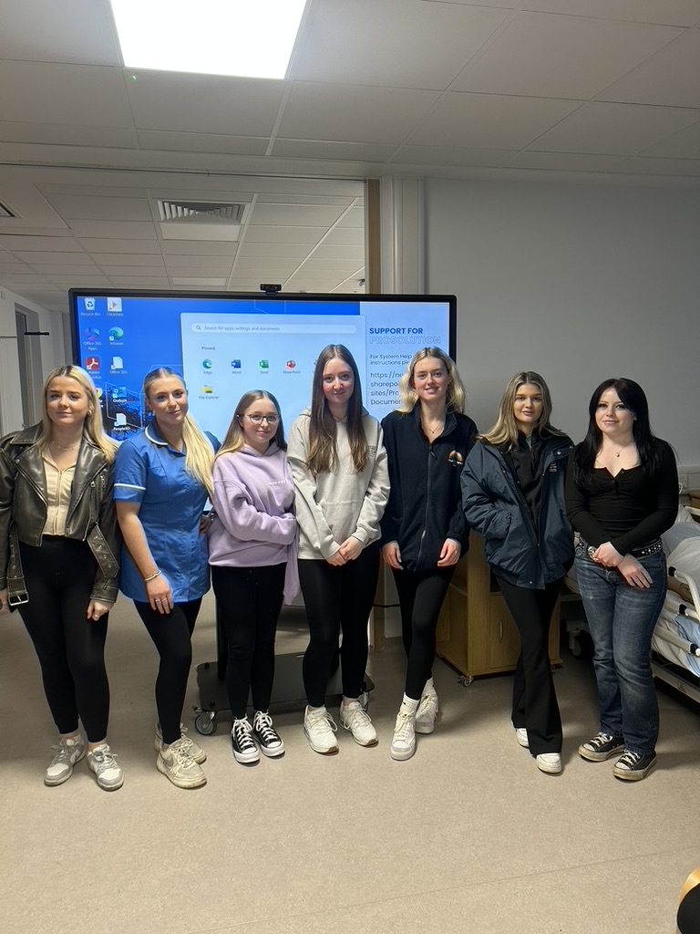







Our students that have progressed to University regularly come back and support our current students.

Slide 19
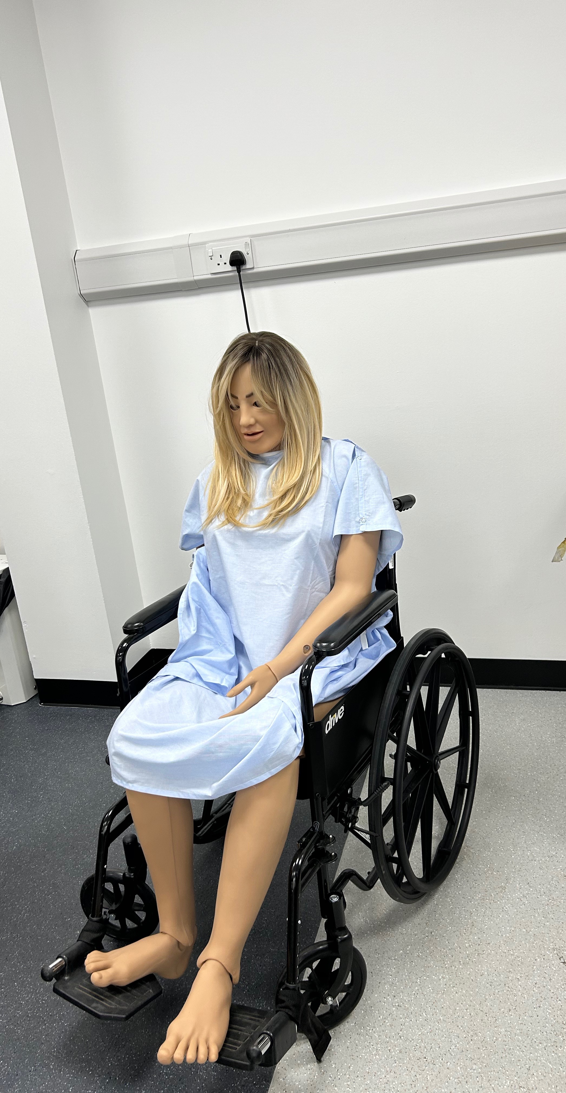
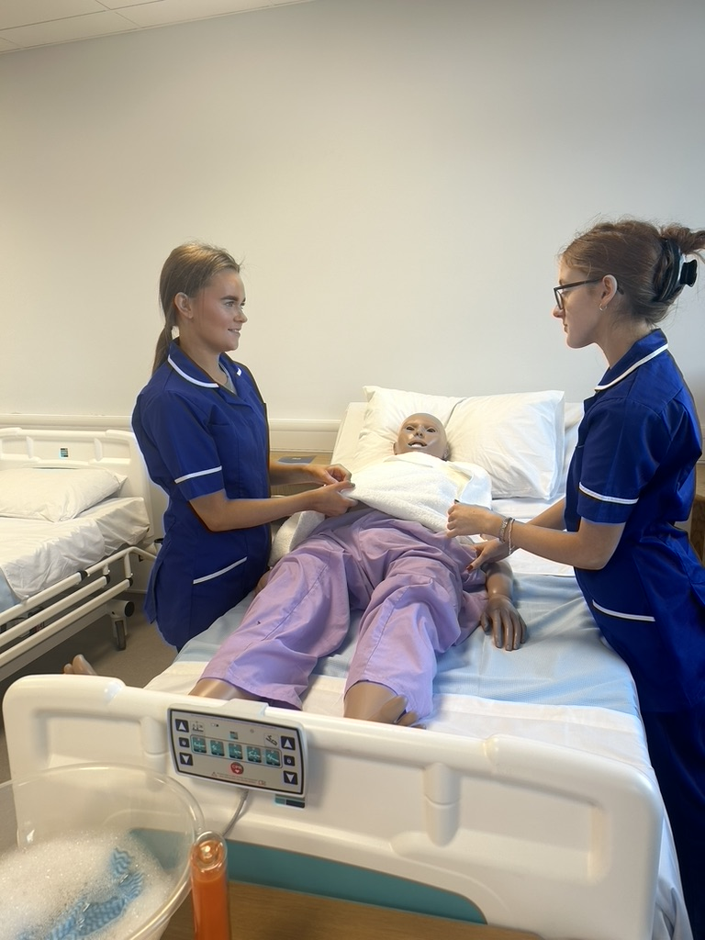
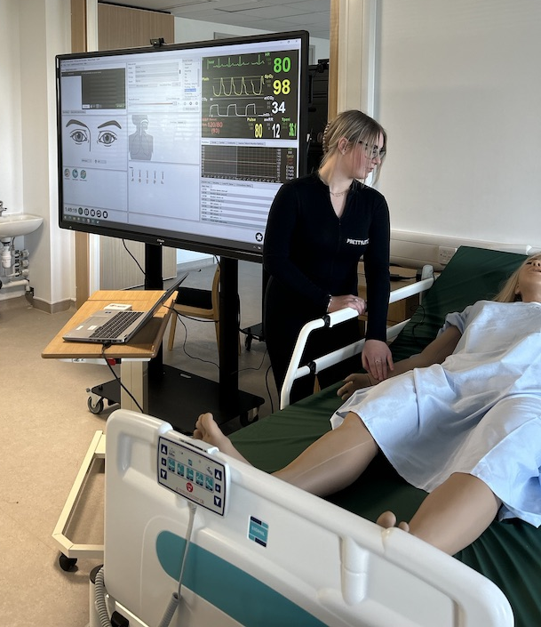
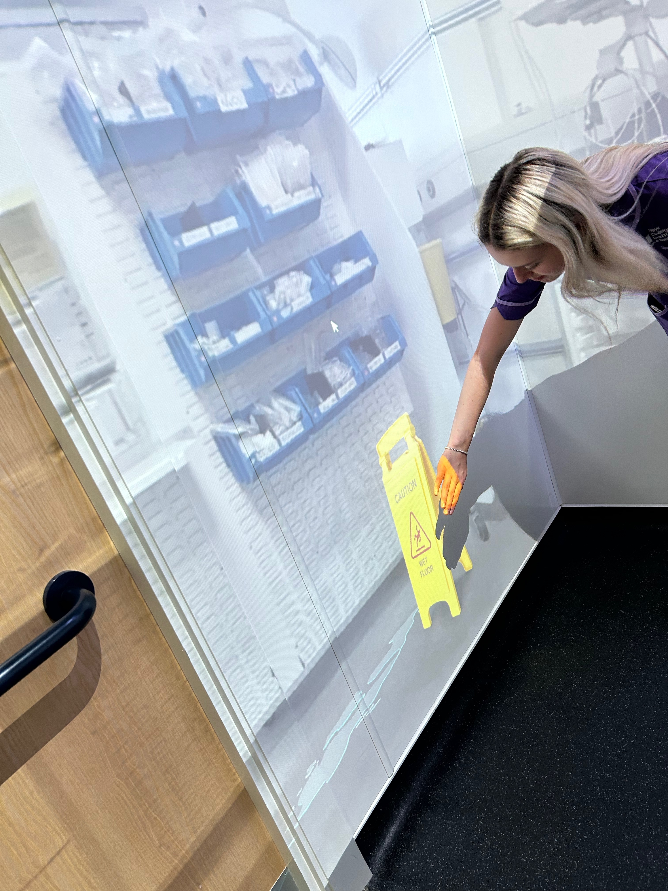
Immersive Igloo
Simulated Wards
Sim Anne – Responsive Mannikin
Sim NewB – Responsive Mannikin
T.H.E Hub

Slide 20
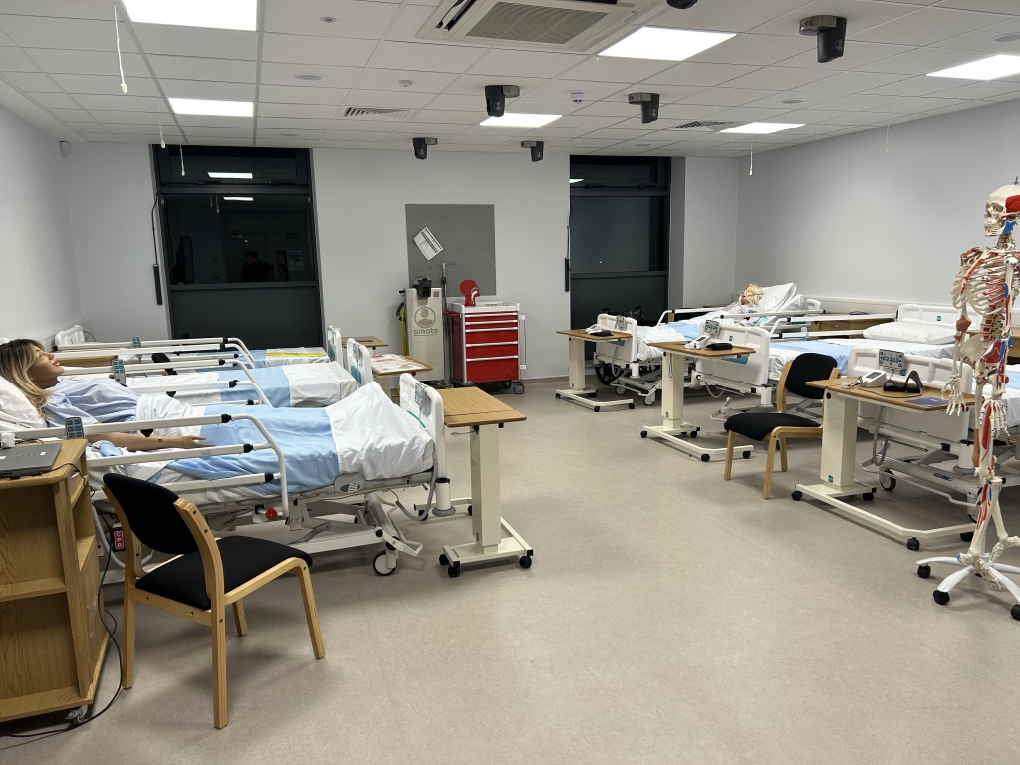
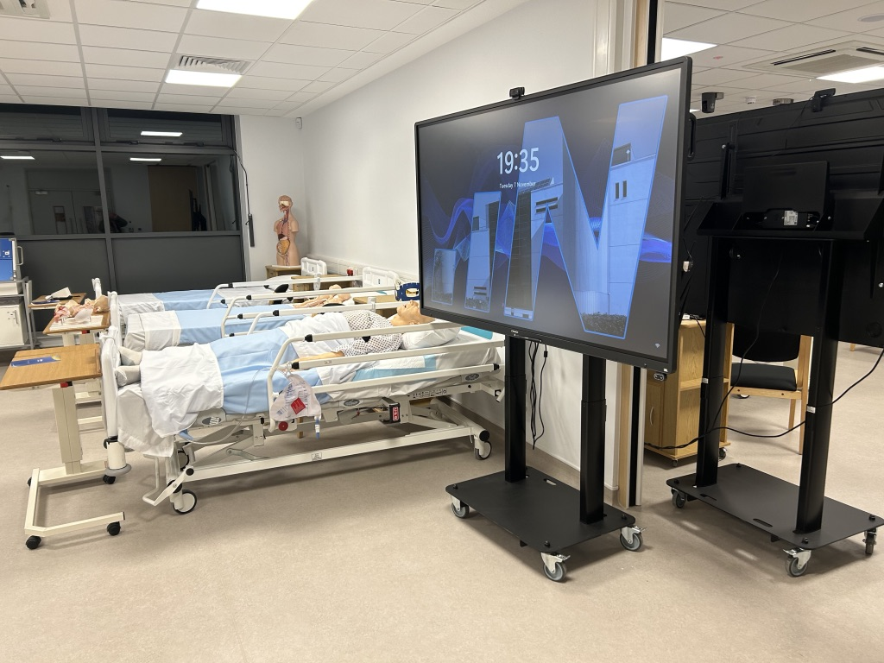
Immersive Igloo
Simulated Wards
Sim Anne – Responsive Mannikin
Sim NewB – Responsive Mannikin
T.H.E Hub

Slide 21
Activities and Opportunities at New College Durham?

Slide 22

Activities and Opportunities
Fundraising for Charities
T Level Year 2 students do a phenomenal job at raising money and collecting Christmas presents for the local Women’s Refuges at Christmas.
Other charities can also be explored at student request.

Slide 23
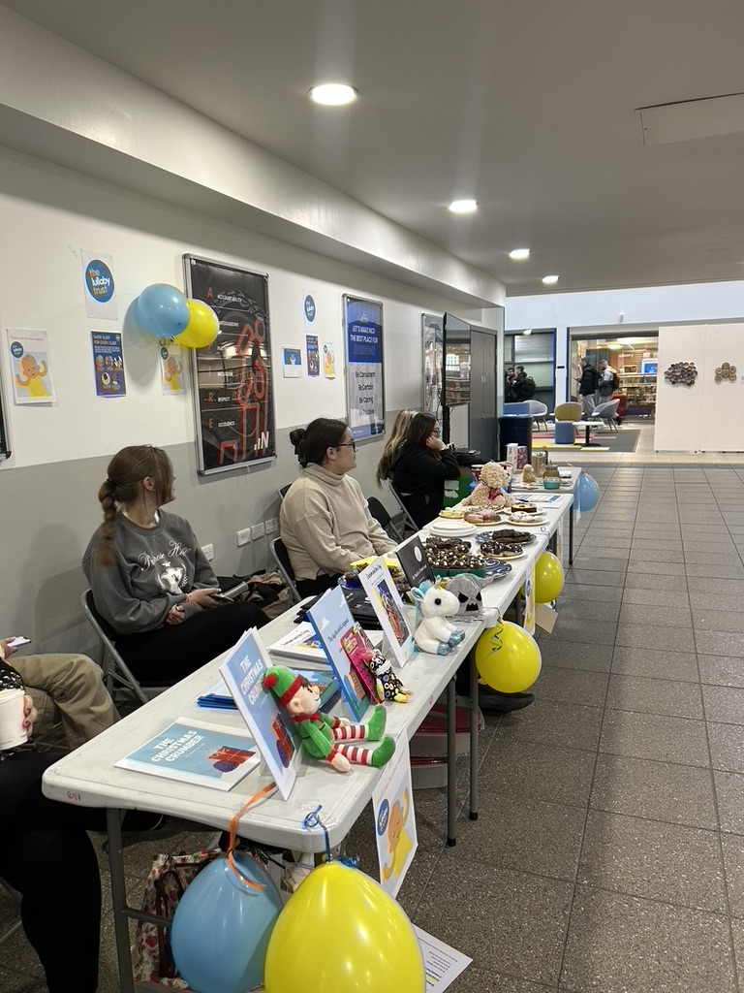
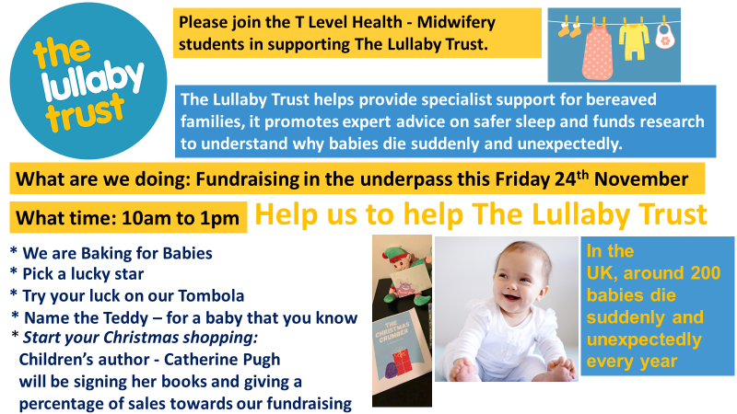
T Level Year 1 students progressing onto the Midwifery Occupational Specialism, did an exceptional job fundraising for the Lullaby Trust.

Slide 24

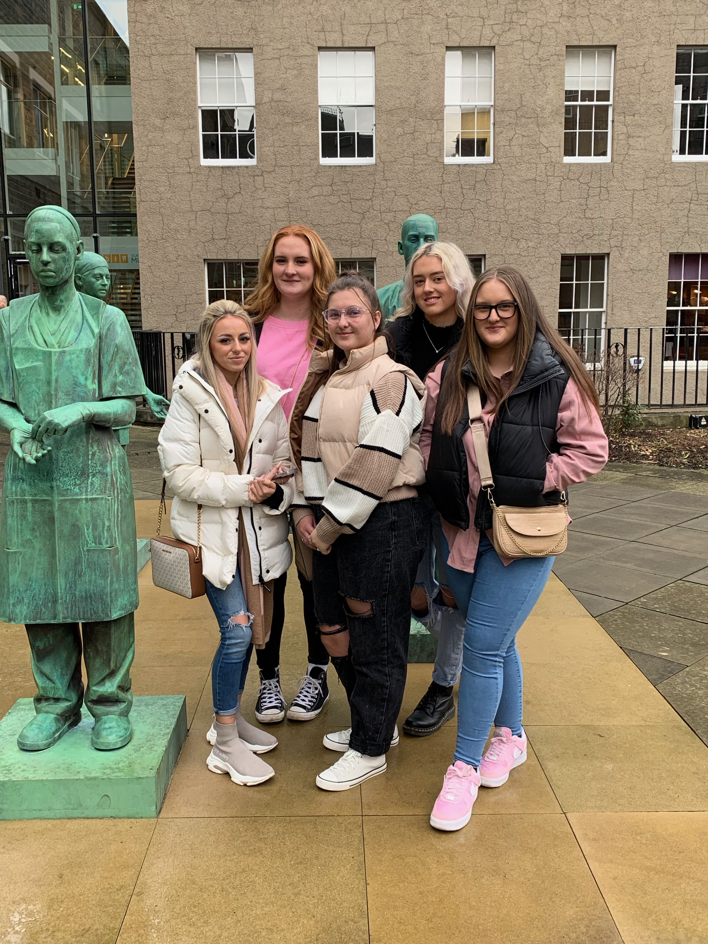
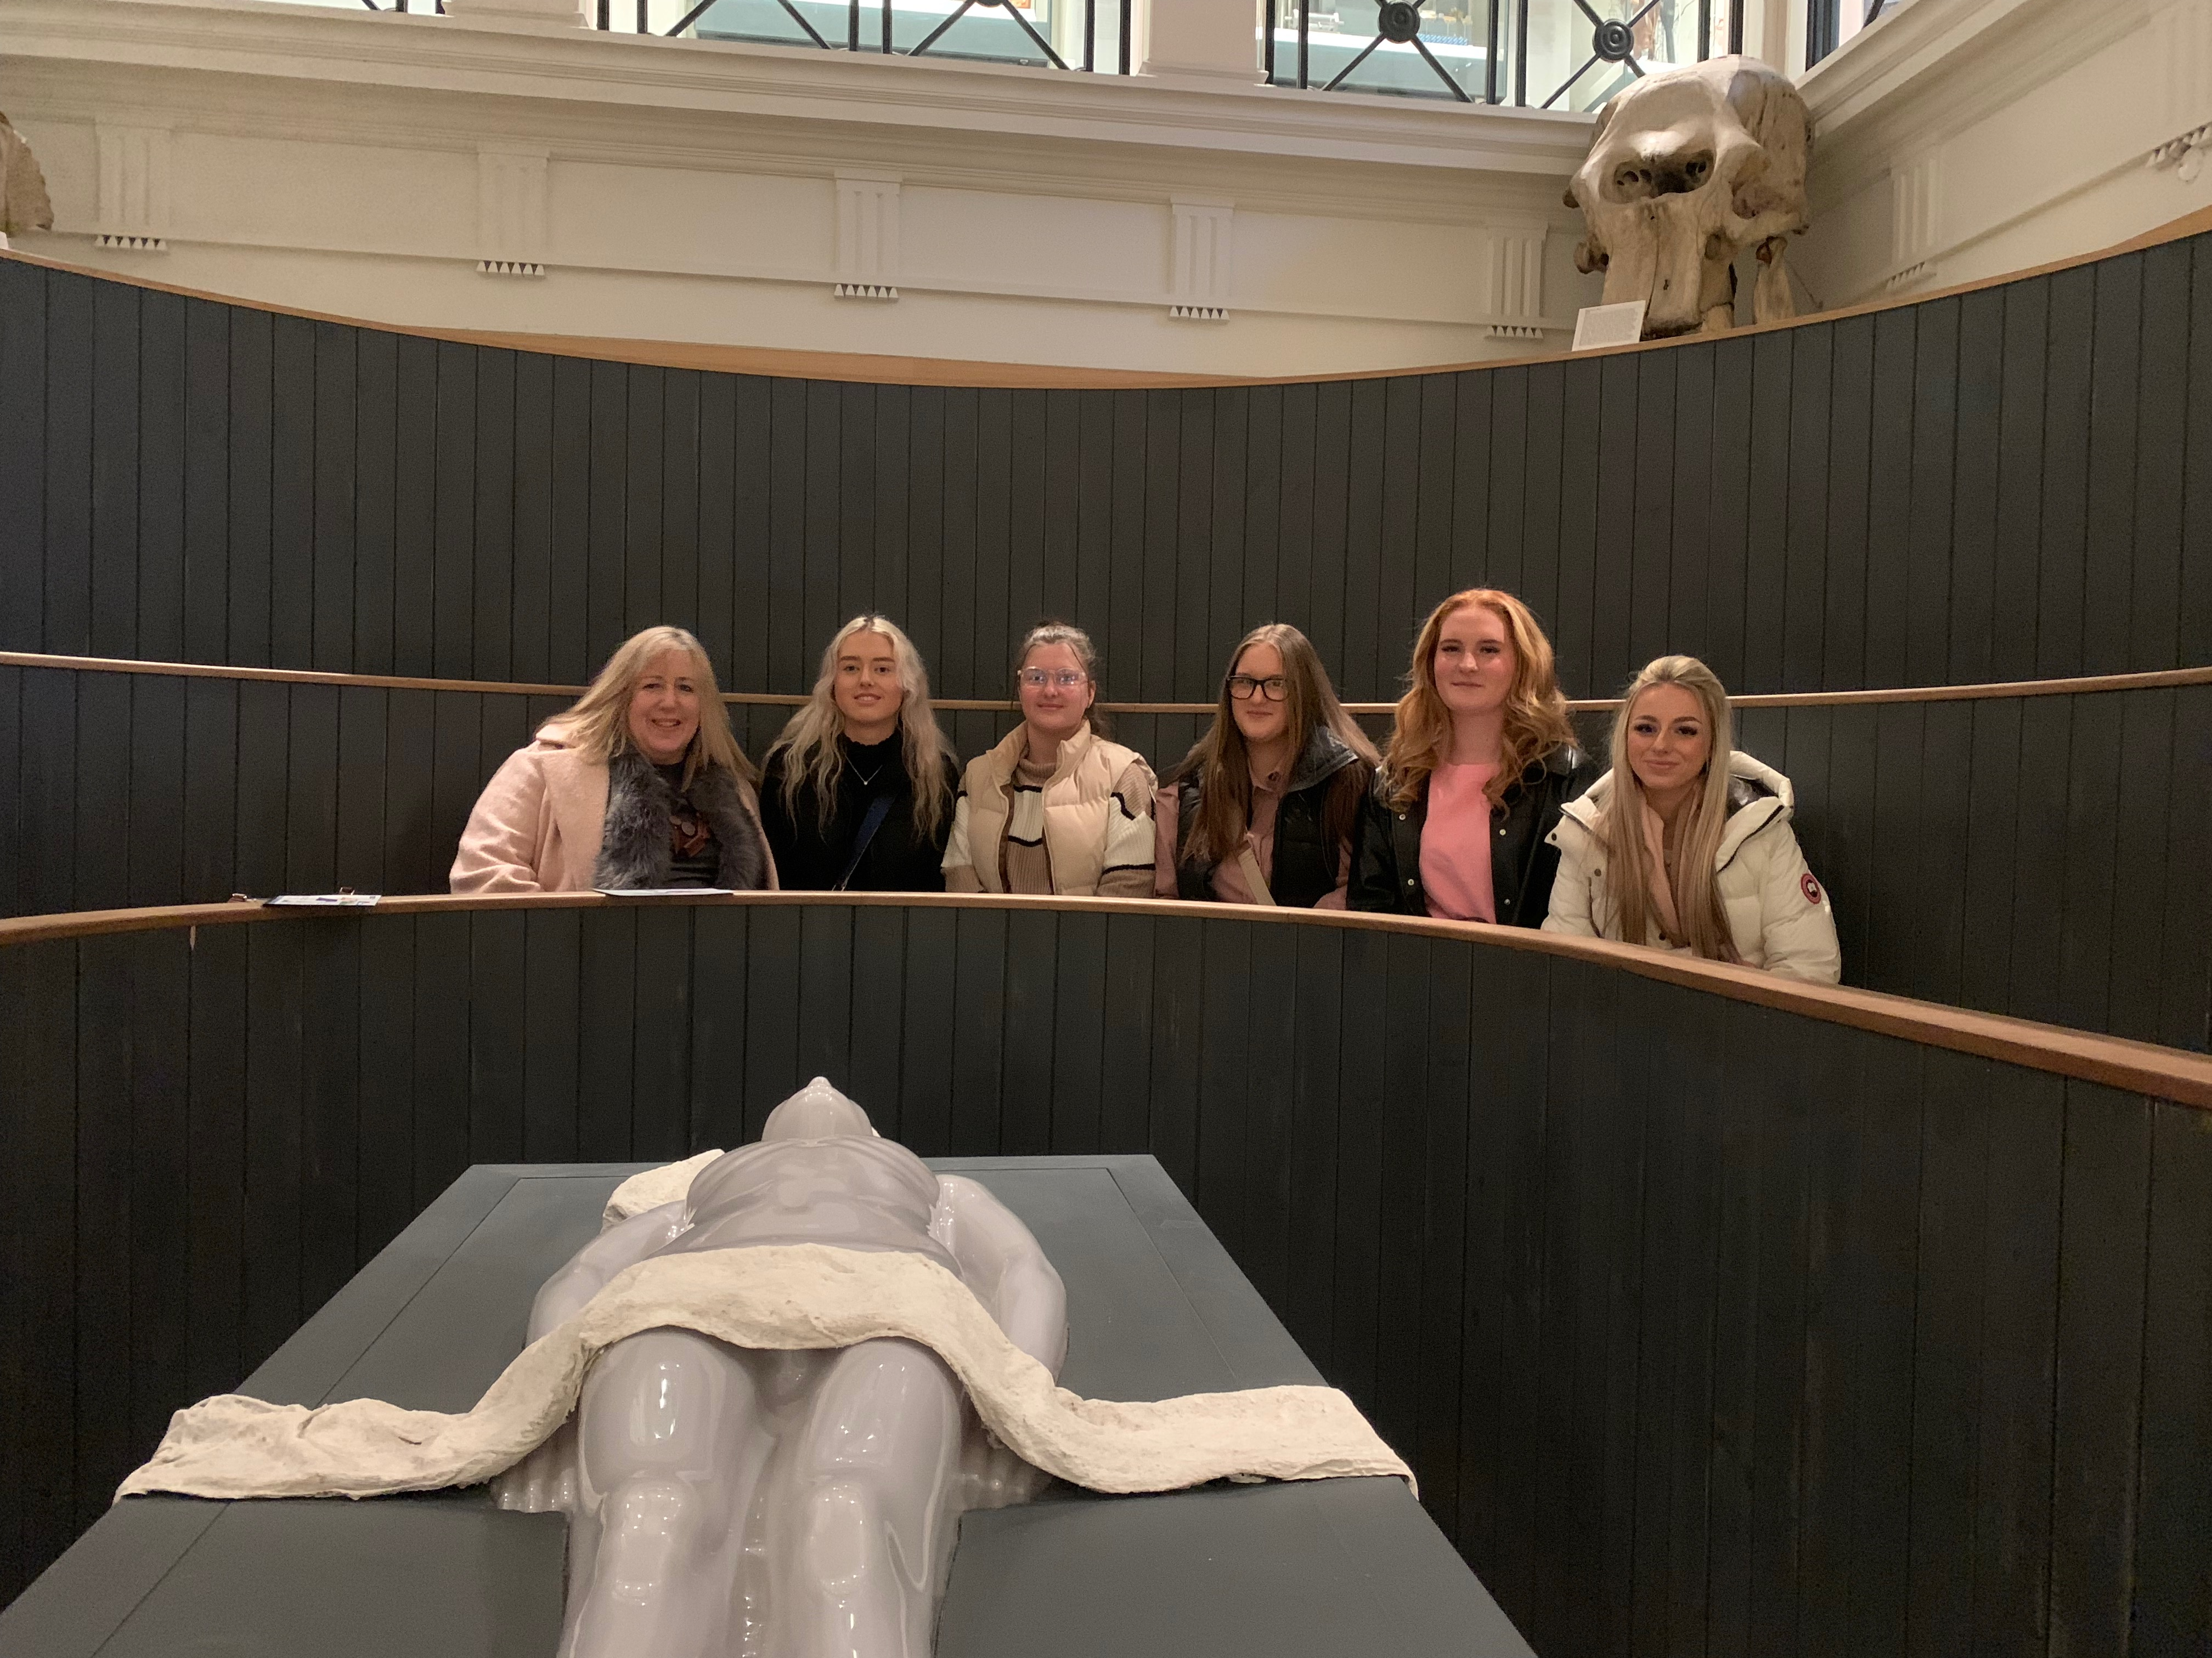
Activities and Opportunities
Day Trips:
Surgeons Hall Museum – Edinburgh
Beamish Museum
York
Outside of College time:
University Workshops
University Open Days

Slide 25
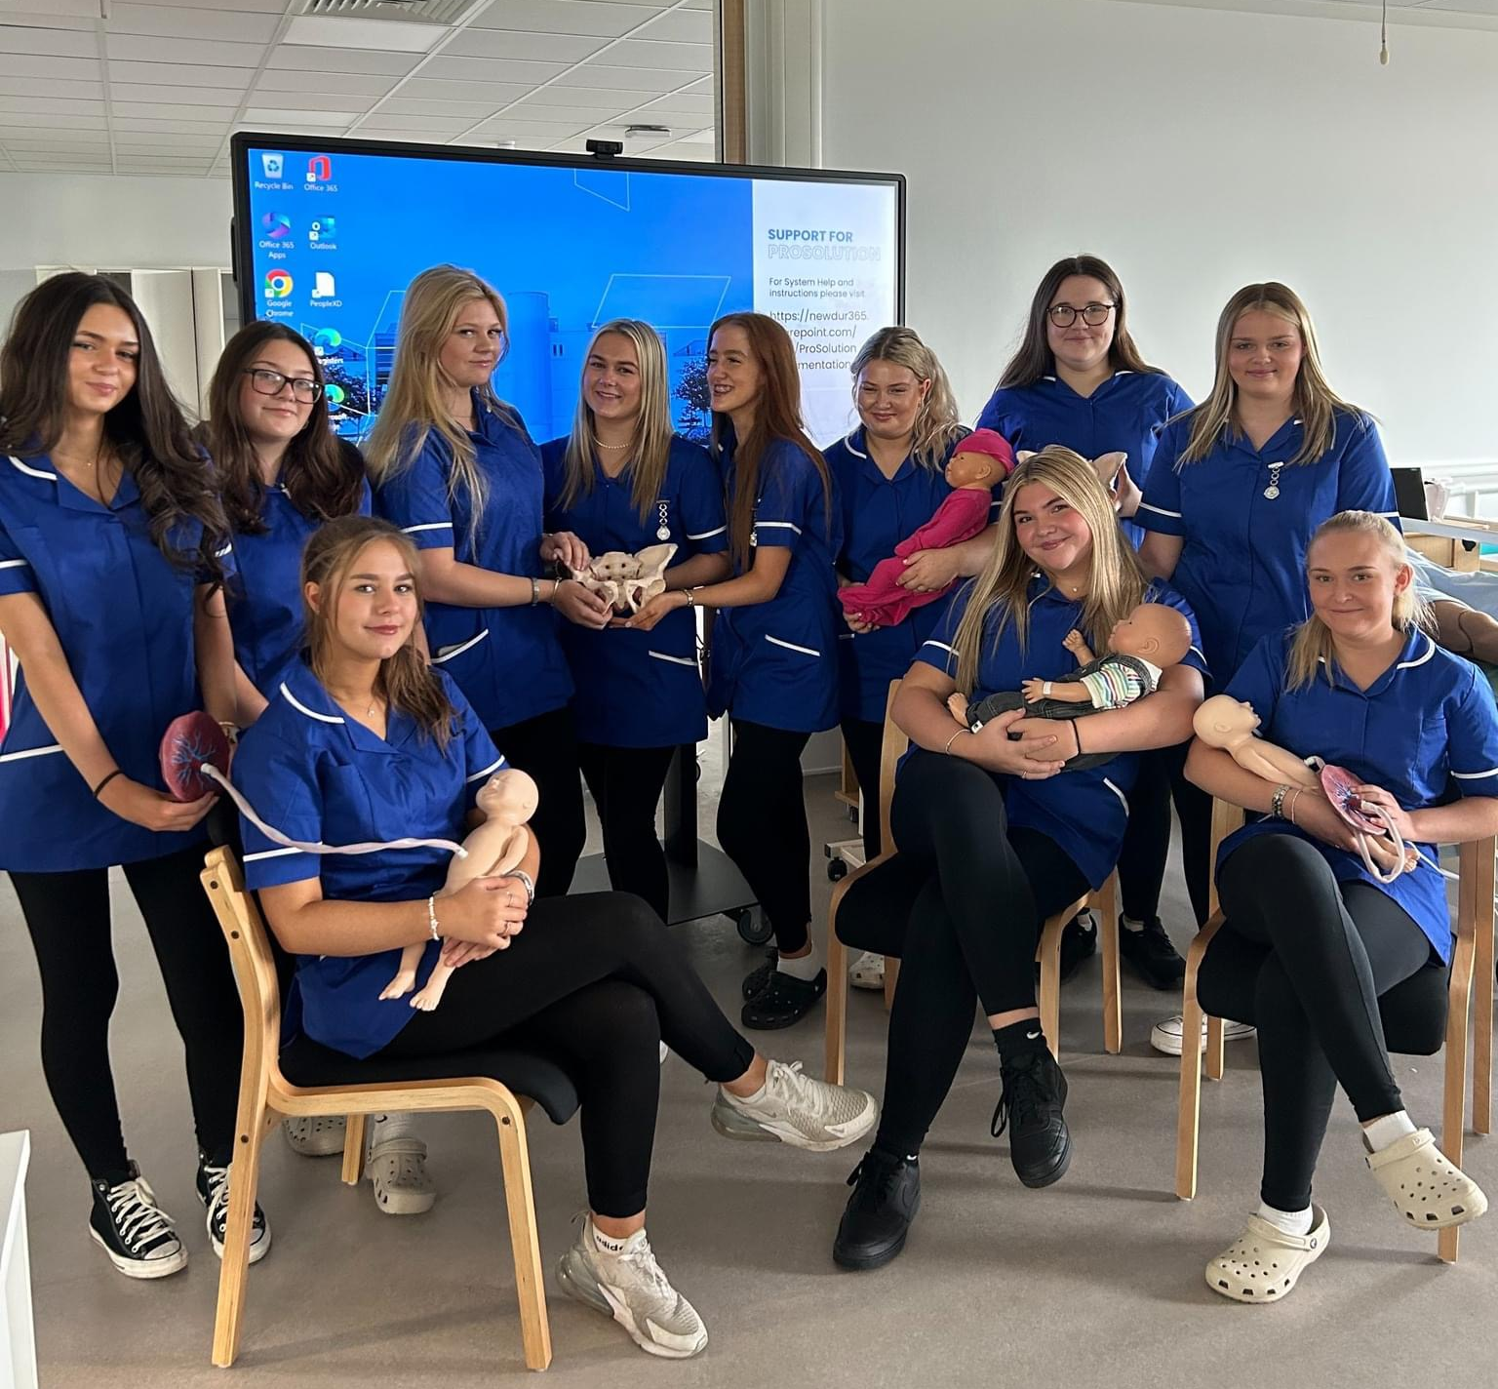

What do you need:
Do not buy until you have started!
Grey tunic
or
Grey polo shirt
Sweat-shirt option

Slide 26

What qualifications do you need?
Maths:
Grade 4 or above
English:
Grade 4 or above
Sciences:
Grade 4 or above
2 other GCSEs:
Grade 4 or above
We hope they are going well ☺

Slide 27


What happens now:
Welcome Fest & Enrolment end of August
Bring in your GCSE results
You will:
Meet your tutor and T Level group
Be given a timetable
Given a lot of this information again!
Commence the course on the 1st of September 2026

Slide 28


Slide 29
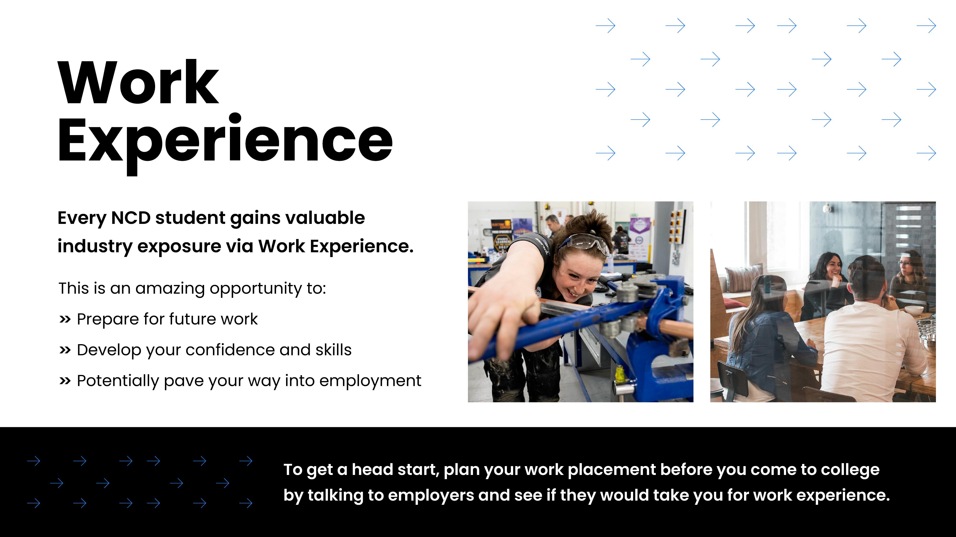

Slide 30


Slide 31


Slide 32
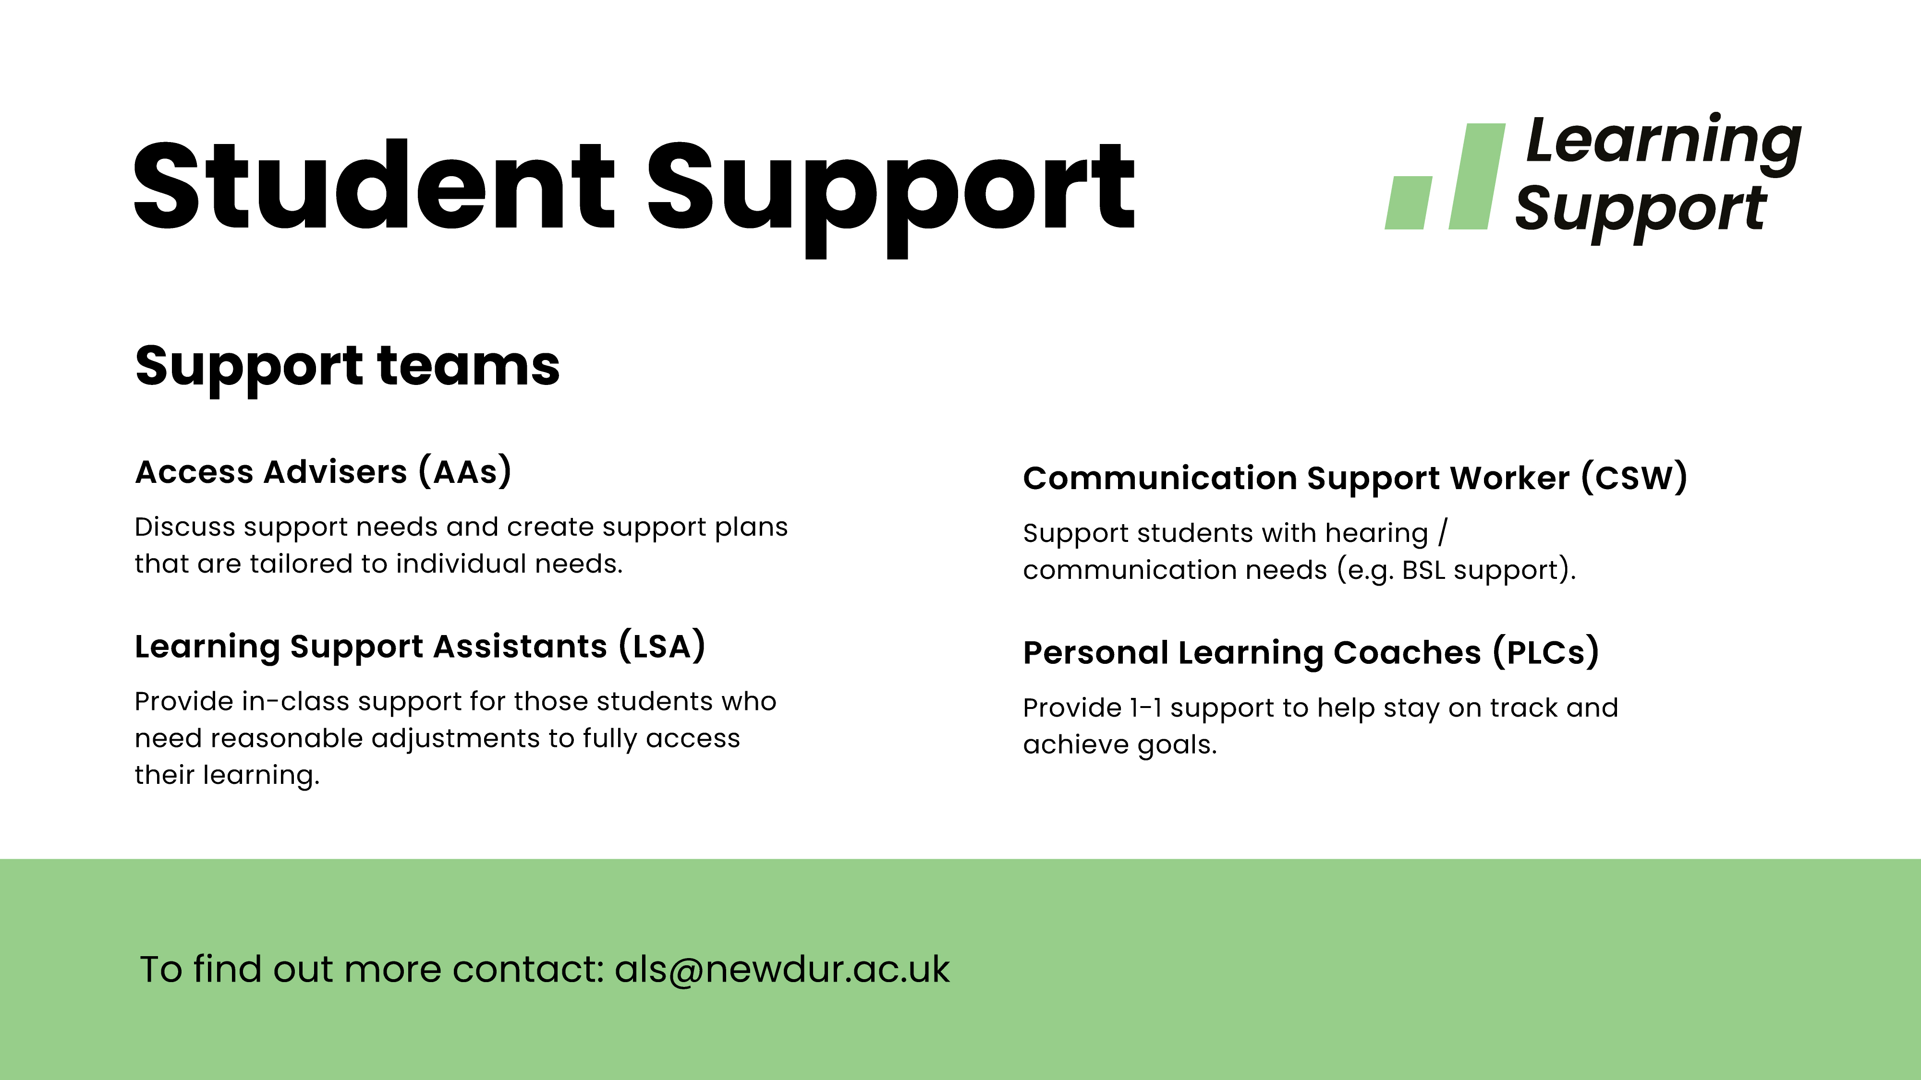

Slide 33
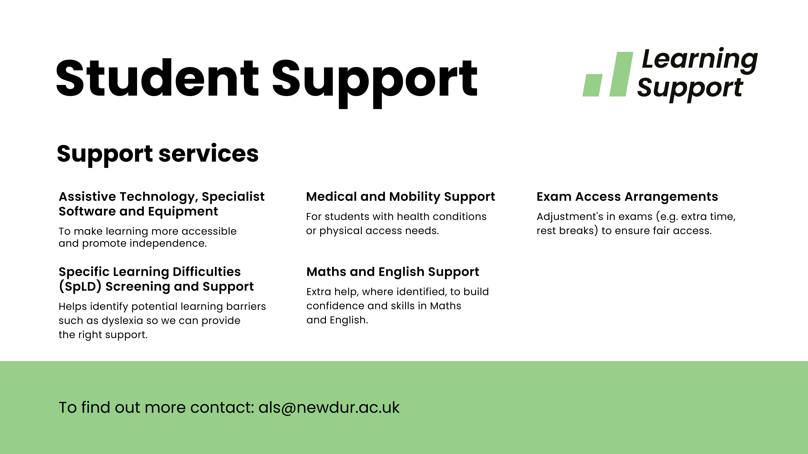

Slide 34
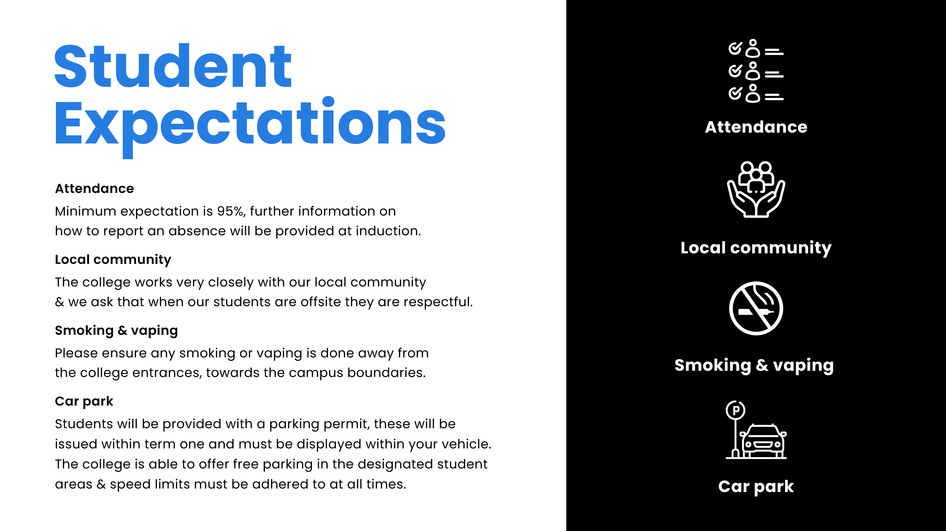

Slide 35
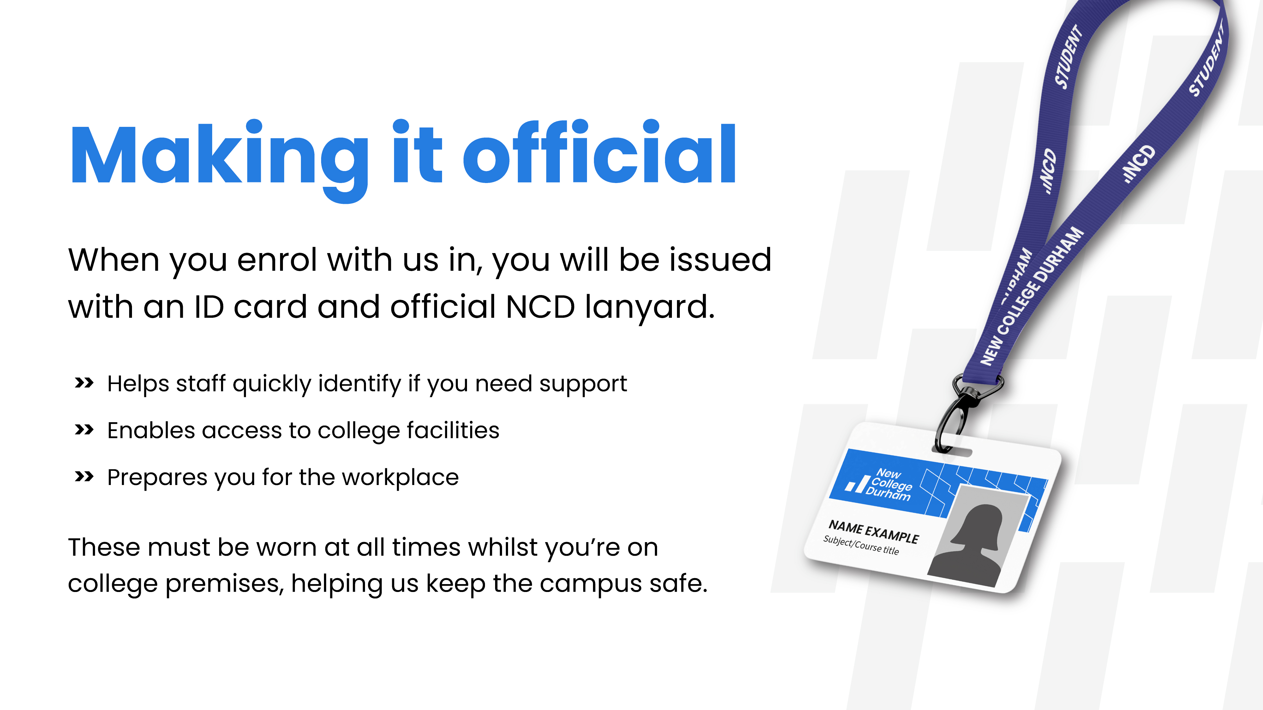

Slide 36
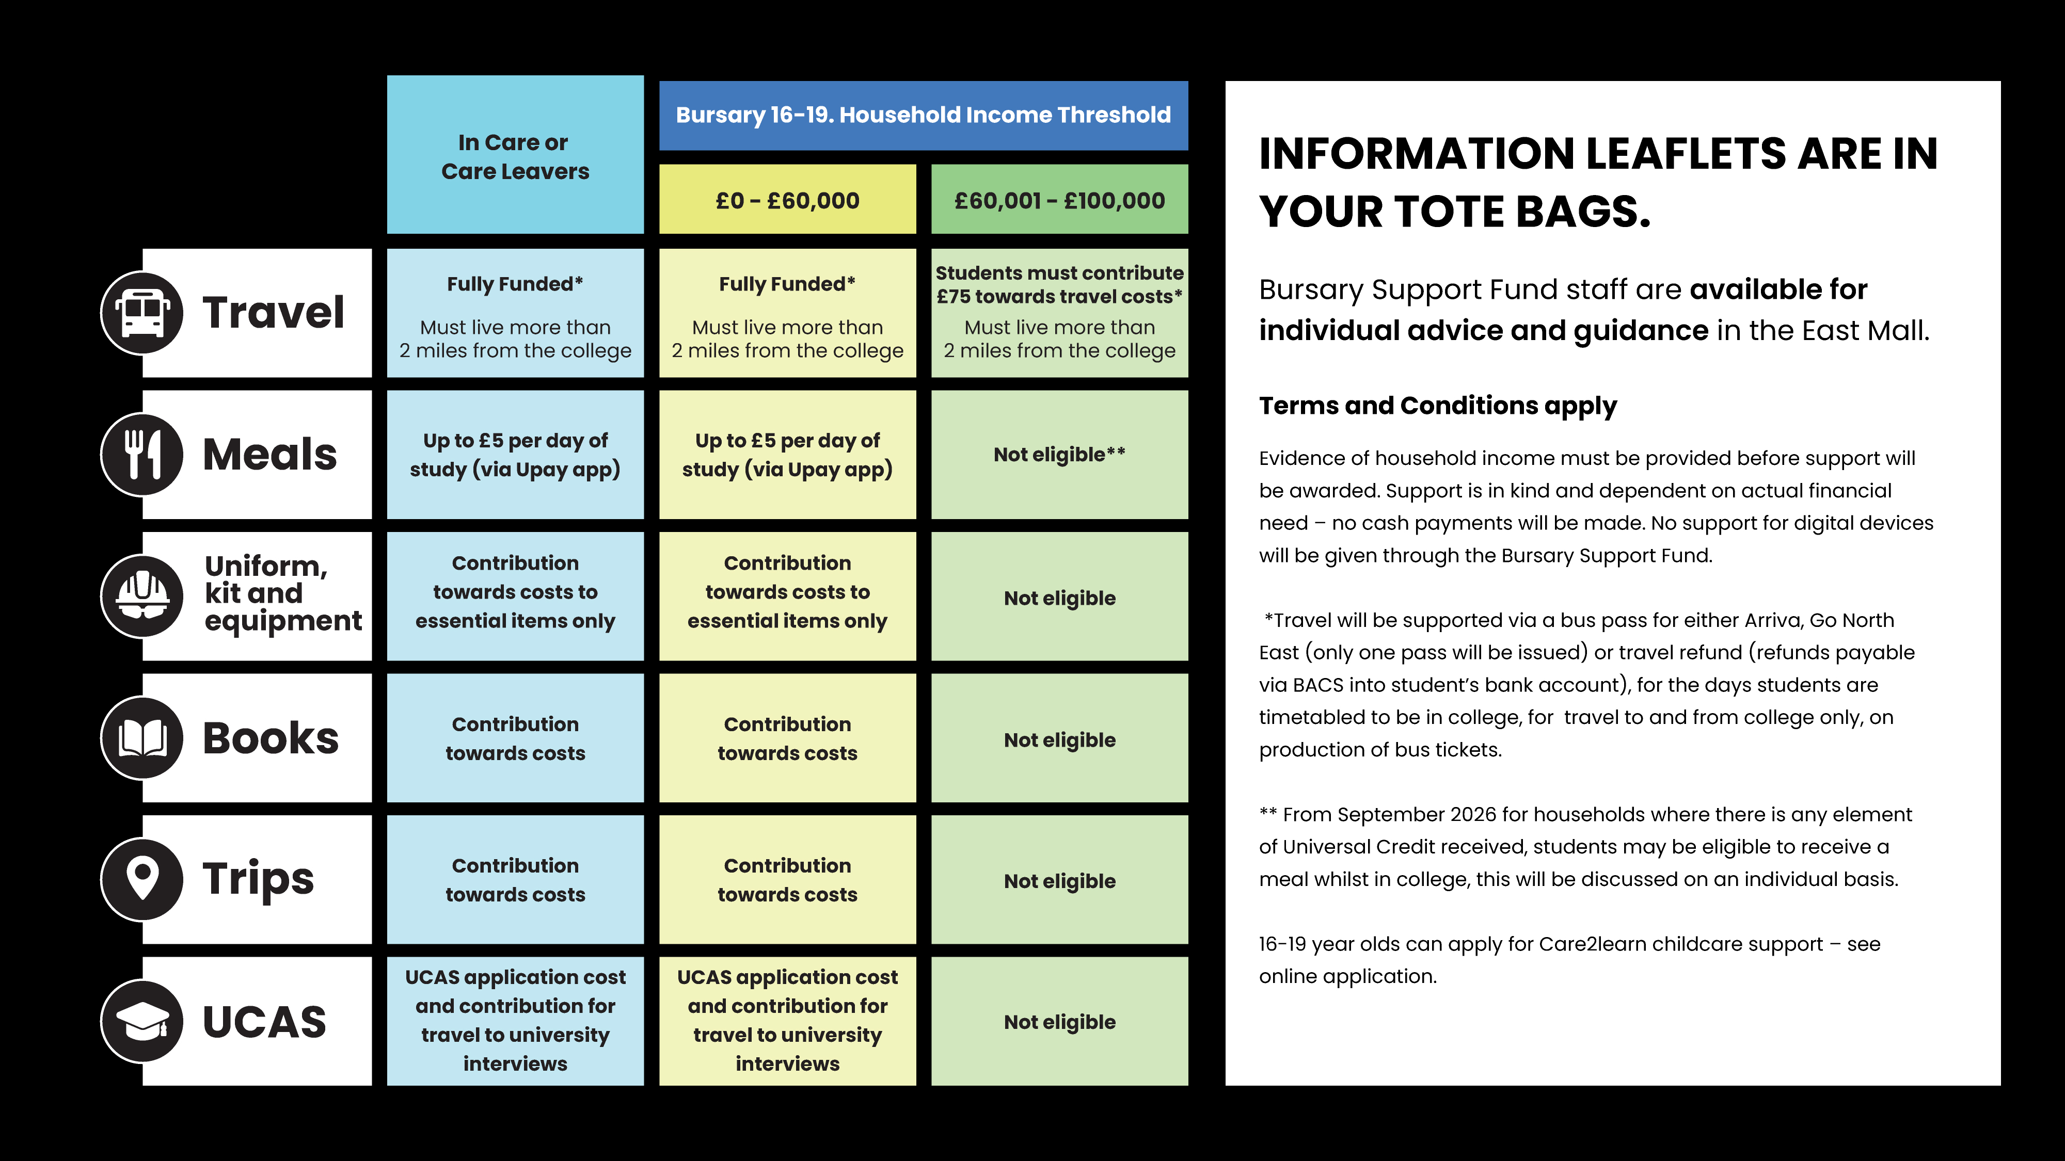

Slide 37


Slide 38


Slide 39


Slide 40


Slide 41


Any questions?
Please take this opportunity to look
around THE Hub

