Slide 1

Get ready for
Sixth Form!
Notes:
Students who attend this event have already applied and have an offer.
This presentation is about getting ready for starting in September

Slide 2

Welcome
Enrolment
Welcome events
First day of term
What to expect in your first week and first term
Equipment and resources
College life and college facilities
Travel passes
Keeping in touch over the Summer
Notes:
Confirm that students have had IAG, applied and have been made an offer.
This evening is about information for the start of term.
We are going to be discussing the following..

Slide 3

Enrolment to A Levels
Enrolment – Thursday 20th and Friday 21st August
From 10am
Please bring..
Your GCSE results slip

Slide 4
Welcome events
Welcome Day – Wednesday 26th August
9am
  Welcome Fest
  Meeting with staff to help confirm your subject choices
  Meet Tutors and new friends!
  Introduction to College, tour

Slide 5

First day of term
Tuesday 1st September
Arrive for 8.30-8.45am
You will be provided with your timetable that day
Lessons start at 9am
Notes:
We will email over the Summer with the details of what time to arrive and where to go.
Staff will meet you – so don’t worry about finding your way!
Lessons start straight away

Slide 6

Your first week & first term
A full introduction to your subjects
Initial assessments in each subject
Personal Development
Notes:
We know some subjects are familiar and others are brand new – lecturers give a full introduction to them all.
We hold short initial assessments in the first week or two. This helps us know how to help you, please don’t worry!
Our annual skills conference sets the scene for life in Sixth Form. Along with a guest speaker, there are workshops on study skills and resilience and it’s a great chance to make new friends.
Personal Development is our pastoral tutor time. There is lots of guidance about college life, and we start to introduce opportunities for enrichment activities and volunteering

Slide 7

Equipment and Resources
A file for each of your subjects (bring them to College every day)
Usual stationery for study – pens, pencils, ruler, file paper, calculator
We provide all textbooks for you to use at home and in College
We provide all lab safety equipment (lab coats, safety glasses)
Notes:
A separate file for each subject. We suggest a ring binder size folder so that is easier to carry.
Some students like to have a larger lever arch file at home for each subject to store older notes in.
There will be regular file checks - we do this to make sure you have all the resources you need in good order to study effectively.

Slide 8

College facilities
You can buy food and drinks at the main food hall, Costa and Starbucks.
We also have a shop selling drinks and snacks.
Library
Football Development Centre
Notes:
Of course you can bring your own food and drinks and you can leave college to go to local shops.
You’ll be given a tour of the library
Gym membership is available to all students, and please let us know if you are interested in joining the Football Development Centre (leave your contact details at the end)

Slide 9
Progression from A Levels?
University
  Degree apprenticeship
  New College Durham – degree programmes on offer
Higher Apprenticeship

Slide 10


Progression
University & Career
Personal statements
Student Finance
Supported Progression Schemes
Independent careers advice
University open days
UCAS guidance
Oxbridge application support
Interview preparation

Slide 11
Progression from A Levels
University
NCD degree programmes
Higher Apprenticeship

Slide 12
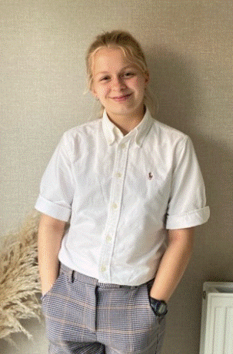
What They Did Next
Meet Liv!
Studied A Level Politics, English Literature and History as well as Extended Project Qualification 2021-2023
Achieved A* in all four subjects
Currently reading Politics at the University of Manchester
“The support and encouragement I received from my teachers at NCD (especially Chris and Jo) was unmatched. I was continually encouraged to push my work and my belief in myself - giving me the confidence to apply to universities, internships and work experience programmes I would not have otherwise applied to! The student support and teaching at NCD were incredibly valuable to my career journey.”

Slide 13
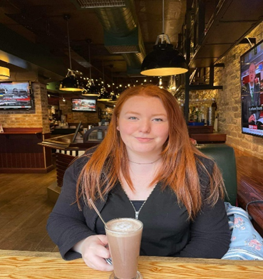
What They Did Next
Meet Jodie
Studied A Level Sociology, Law and Criminology at NCD 2015-2017
Law degree at Northumbria University
Worked in the South of France in Toulon and Saint Tropez as part of her degree
Worked for Northern Space and Security Ltd
Worked at David Gray Solicitors in Newcastle as a Wills and Probates solicitor.
Has returned to NCD to take up a role in our administration services.

Slide 14
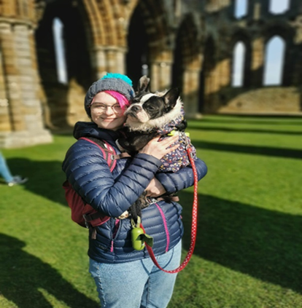
What They Did Next
Meet Lisa (and Lola!)
Studied A level Sociology at NCD 2012-2014
BSc (Hons) in Sociology at Chester University
MA in Media and Cultural Studies at Sunderland University
PGCE in Post Compulsory Education and Training at Sunderland University
GCSE Math's teacher at Darlington College
October 2022- present PhD in Media and Communications at Sunderland University and Sociology lecturer at NCD!

Slide 15
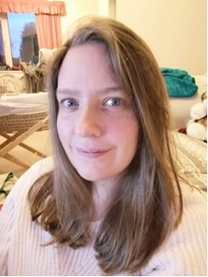
What They Did Next
Our very own Debs!
Studied A Level Sociology at NCD 2007- 2009
BSC (Hons) in Sociology at Northumbria University
PGCE in Post Compulsory Education and Training at NCD (Teesside)
Learning Support Assistant at NCD
Criminology/Sociology Lecturer at NCD

Slide 16
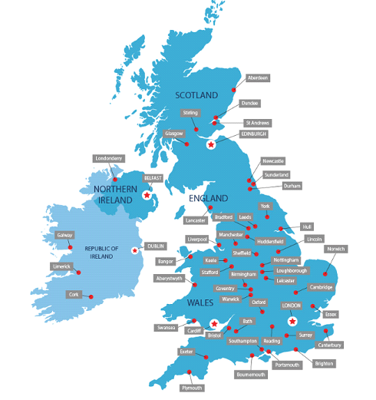
Progression
Durham University
Teesside University
Law
Archaeology
Crime Scene Science
Nursing
Forensic Psychology
University of Newcastle
Chemistry
Biomedical Sciences
Marine Biology
English Literature
Engineering
Law

Slide 17

Notes:
Our students gain confidence and they spread their wings.
They go on to study a diverse range of subjects from Robotics to History. They study at Universities across the country

Slide 18


Slide 19


Slide 20


Slide 21


Slide 22


Slide 23
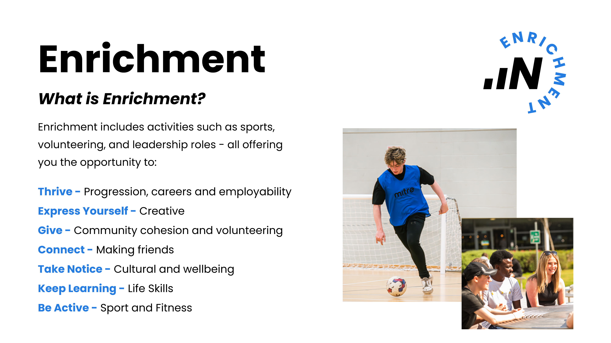

Slide 24


Slide 25


Slide 26


Slide 27


Slide 28

Check your inbox!
Additional Details Form
Email for New Applicants – please complete this as soon as possible if you have not already done so.
Thank you!
Notes:
Fran

Slide 29
Dates for your diary
Notes:
We know some subjects are familiar and others are brand new – lecturers give a full introduction to them all.
We hold short initial assessments in the first week or two. This helps us know how to help you, please don’t worry!
Our annual skills conference sets the scene for life in Sixth Form. Along with a guest speaker, there are workshops on study skills and resilience and it’s a great chance to make new friends.
Personal Development is our pastoral tutor time. There is lots of guidance about college life, and we start to introduce opportunities for enrichment activities and volunteering

Slide 30
Dates for your diary
20th and 21st August – enrolment from 10am
1st September – teaching begins
Weeks beginning 30th November 2026 and 1st March 2027 – mock exams
Week beginning 10th May 2027 – AS exams begin
Friday 18th June 2027 – end of academic year

Slide 31


Slide 32

Thank you!
We are looking forward to you joining us in Sixth Form!
Please contact us if you need any further advice and guidance:
Steve Ireland (Head of School)
Stephen.Ireland@newdur.ac.uk
Wendy Harrison (Curriculum Manager for A levels)
Wendy.Harrison@newdur.ac.uk
Notes:
If you have any questions or concerns please contact us – we are open all Summer.
You don’t need to come in specially to enrol – we will do this with you in Welcome Week

