Slide 1

NCD Music

Slide 2

Always Top Performing

Slide 3


Curriculum Team
Head of School
Curriculum Manager
HE Programme Lead ​
FE Programme Lead L2 + L3
Department Technician
Karen Sammut
Simon Jefferson
Jake Fletcher
James Perkins
David Nicholson

Slide 4

Programme Content
Theory
Context
Practice
Creativity
Technology

Slide 5


Entry Requirements
For L3 minimum of four GCSEs at grade 4 (C) or above (or equivalent), including English and Maths.
If you have GCSE Music we would expect a grade 4 (C) or above.
If you have not achieved a grade 4 (C) or above in M&E, you must study the necessary qualification at college.

Slide 6

Study Programme
Full Time Programme incorporating:
BTEC Music qualification
English and Maths (if you have not achieved grade 4 or above)
Developing Work Ready Skills
Work placement
Enrichment

Slide 7

Departmental Move
A New Chapter for Music at the College – we are launching this September in a brand-new, purpose-built Music department.
A major £700,000 investment in state-of-the-art facilities designed specifically for our students, creating an inspiring environment to learn, create and perform.
Outstanding spaces and equipment for performance, rehearsal and recording/music production, supporting every aspect of musical development.
A significant step forward for the department, providing the resources and facilities to support future growth and innovation.

Slide 8


Slide 9


Slide 10
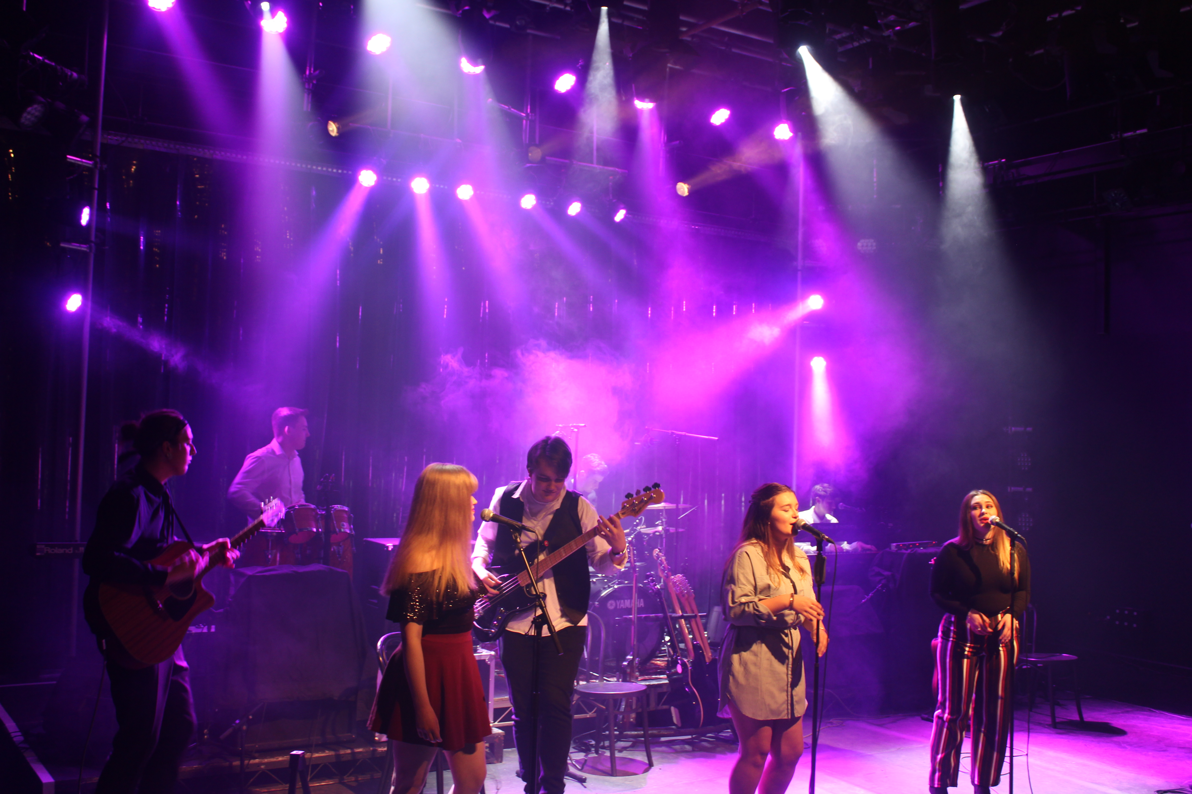
Work Experience
ALL students should seek a relevant work placement
Equivalent to minimum 2 weeks (70 hours) per Academic Year
Students to source meaningful work placement through friends, family or speculatively.
NCD will carry out Health and Safety Assessments and approval is needed BEFORE the work placement can commence.

Slide 11
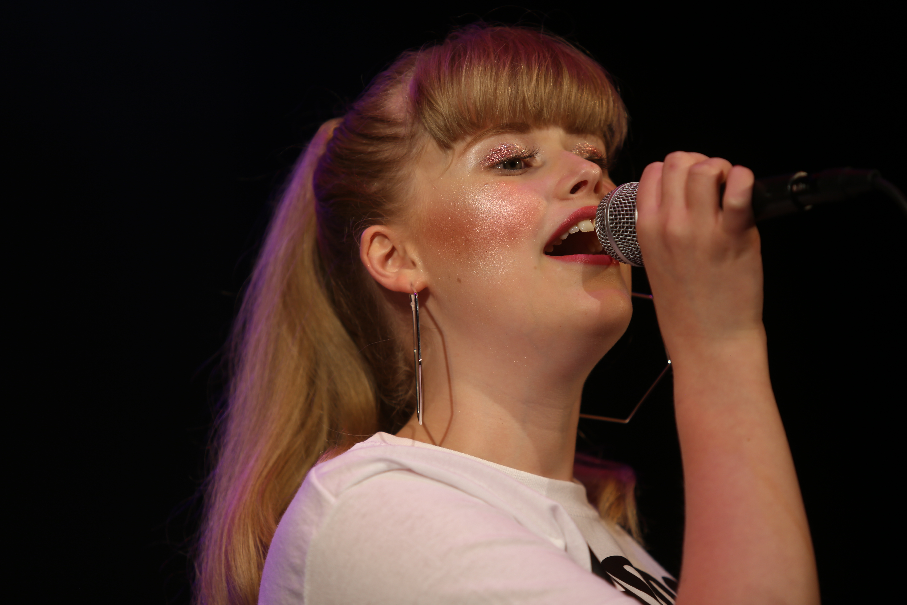
Expectations
Full attendance in all lessons including Maths & English where applicable
Ability to maintain excellent punctuality
Positive and enthusiastic attitude
Ability to meet deadlines
Commitment to your full study programme
(including homework, English and Maths, work placement and participation in enrichment activities)
Full participation in all lessons
Participation in 2 weeks (70 hours) meaningful work experience
Commitment to independent study and instrument practice

Slide 12


Slide 13


Slide 14


Slide 15


Slide 16


Slide 17


Slide 18


Slide 19

?
Time for Questions

Slide 20


Slide 21


Slide 22


Slide 23


Slide 24
THANK YOU

