Slide 1


GET NCD READY:
LEVEL 2 CERTIFICATE IN ACCOUTNING (AAT)
How far do you want to go in accounting?

Slide 2
In Case of an Emergency
Fire – If the fire alarm sounds, please calmly make your way to the nearest fire exit and head to your nearest meeting point. Please do not go back into the building unless you’re told it's safe to do so.
First Aid – For all first Aid requirements please contact Security 0191 375 4059/4058

Slide 3

Welcome – Staff Introduction
Devonne Burn
Treana Havelock
Aidan Jackson

Slide 4
Contacting Your Programme Team
You can contact your Programme Team by email.
Devonne Burn Devonne.Burn@newdur.ac.uk
Treana Havelock Treana.Havelock@newdur.ac.uk
Aidan Jackson Aidan.Jackson@newdur.ac.uk
Please allow 48 working hours for a response.
Please remember that some staff don’t work full time which may affect response times.

Slide 5
AAT Welcome Video
Welcome Video - https://vimeo.com/869477757/9c2dcabf5c?share=copy

Slide 6

ENTRY REQUIREMENTS
GCSE MATHS
4 or above
GCSE ENGLISH
4 or above

Slide 7
Start of Term Information
All full-time further education courses start | Tuesday 1 September 2026
AAT Accountancy Level 2 Further Education
Programme Timetable will be provided at Welcome Fest.

Slide 8


Slide 9

To get a head start, plan your work placement before you come to college by talking to employers and see if they would take you on for work experience.

Slide 10


Slide 11


Slide 12


Slide 13
AAT accounting qualifications
 | Level 2 Certificate in Accounting | Level 3 Diploma in Accounting | Level 4 Diploma in Professional Accounting
Who are they suitable for? | School-leavers Returners to work Those who have not studied for a while | Those with previous accountancy/finance experience Relevant A-level qualifications Confident at starting at a higher level | Someone with advanced knowledge and skills (such as someone who's complete the Advanced Diploma or someone with an Accounting degree)
Covers | Develop your skills in finance Administration including: Double-entry bookkeeping Purchase, sales and general ledgers Basic costing | Advanced accounting skills including: Maintaining cost accounting records Advanced bookkeeping Preparation of financial reports and returns | Develops financial team leader skills: Drafting financial statements for limited companies recommending accounting systems strategies constructing and presenting complex management accounting reports

Slide 14



Your AAT Journey
Level 3
Level 4
Level 2
AAT
Diploma in Accounting –
1 Year FE Programme (Full time)
Or
Via the L3 Assistant Accountant apprenticeship standard
Professional Diploma in Accounting via AAT Level 4 apprenticeship Professional Accounting Technician standard.
Certificate in Accounting – 1 Year FE Programme (Full time)
Students age 16-18 - To progress onto the AAT Level 3 Diploma in Accounting Further education full time, or VIA The Assistant Accountant apprenticeship standard v1. 2
Students age 19+ can complete the AAT Level 3 Diploma in Accounting Part time.
On successful completion of AAT Level 3 you can apply to become an AAT bookkeeping member (AATQB).
AAT bookkeeping membership, gives you professional recognition using the designatory letters AATQB after your name, and you can apply to become self-employed and offer bookkeeping services as an AAT Licensed Bookkeeper.
AAT Level 4 (On successful completion, apply to become a full member and receive professional recognition by using the designatory letters MAAT after your name)

Slide 15
Our qualifications are the perfect first step to becoming a chartered accountant. They offer a fast-track route to help you get there quicker than going to university. Plus, the practical skills and knowledge you'll gain while studying AAT will complement the chartered syllabus, helping you to succeed.
On completion of the AAT Level 4 Diploma in Professional Accounting, you can gain exemptions from all the UK chartered and certified bodies:
ACCA: Association of Chartered Certified Accountants
CIMA: Chartered Institute of Management Accountants
CIPFA: Chartered Institute of Public and Finance Accountancy
ICAEW: Institute of Chartered Accountants in England and Wales

Slide 16
The AAT Level 2 Course Qualification Consists Of 4 Units:
Principle of Costing (PCTN)
Introduction to Bookkeeping (ITBK)
Principles of Bookkeeping Control (POBC)
Business Environment (BESY) - Synoptic Assessment.

Slide 17
Overview of Assessment Process
The proportion of this qualification assessed by externally marked assessment is 100%.
All assessments in this qualification:
• are set and marked by AAT
• are computer based
• are time-limited
• are scheduled by training providers or assessment venues
• Take place at New College Durham, we are an approved training provider and assessment venue.
• Take place under controlled invigilated conditions.
Grading for Q2022
Pass | = 70% to 79%
Merit | = 80% to 89%
Distinction |  | = over 90%

Slide 18


Slide 19



Slide 20


Slide 21
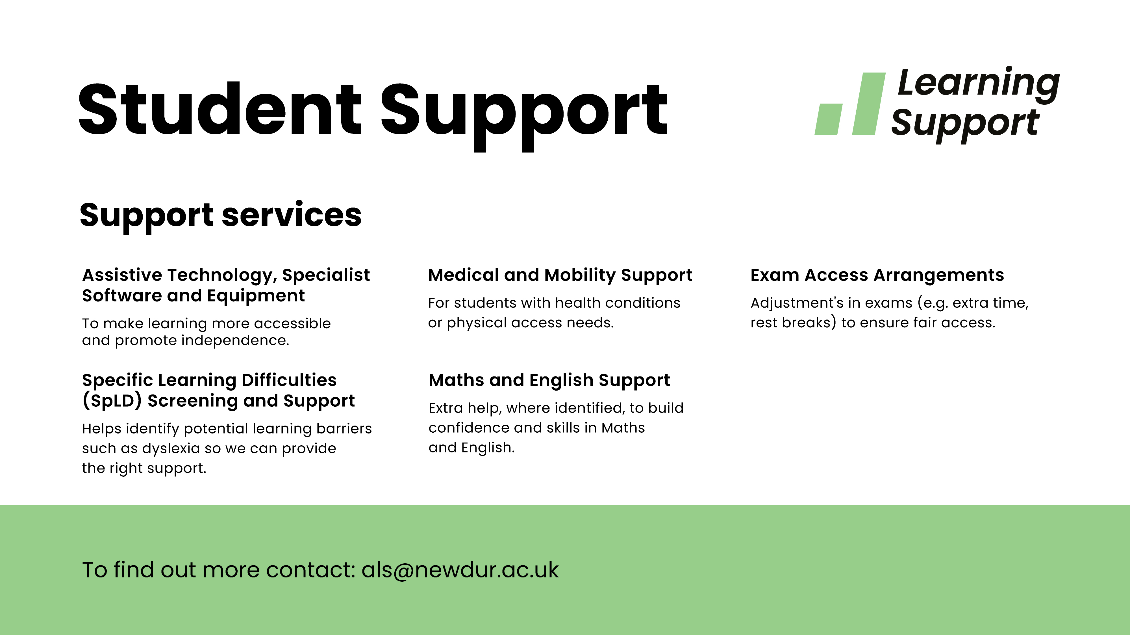

Slide 22


Slide 23


Slide 24


Slide 25


Slide 26
Any Questions?

